Slide 1
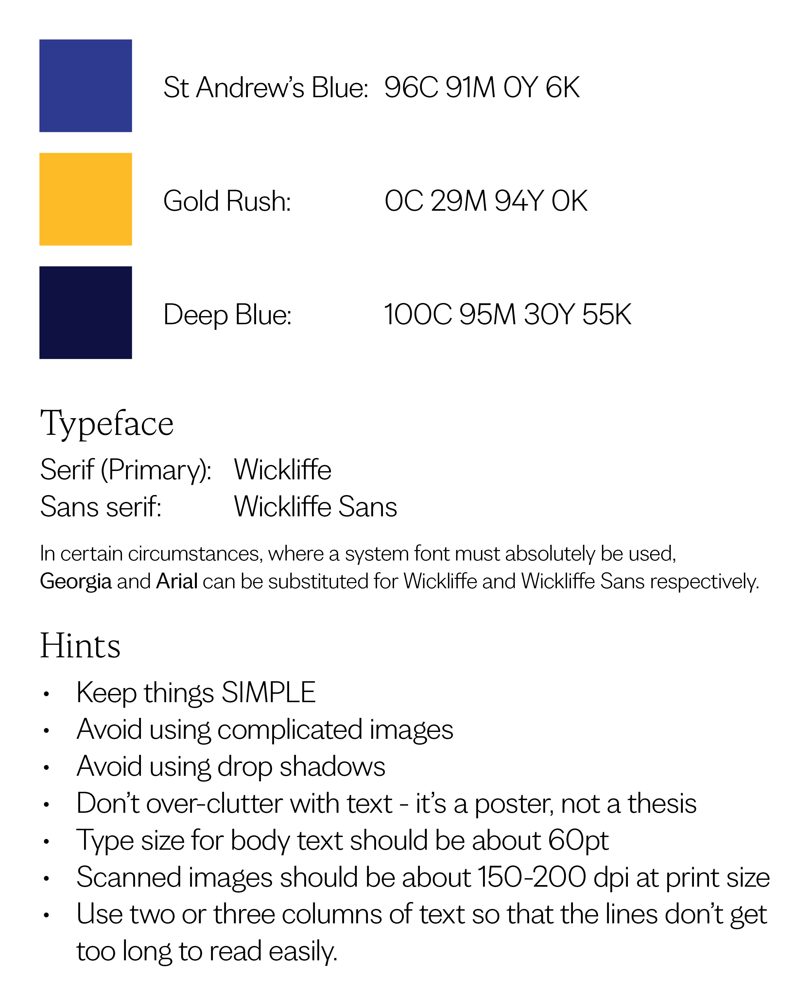
Header goes here (about 200pt)
Subheader goes here (about 100 pt)
Body copy goes here (about 60 pt)

