Slide 1
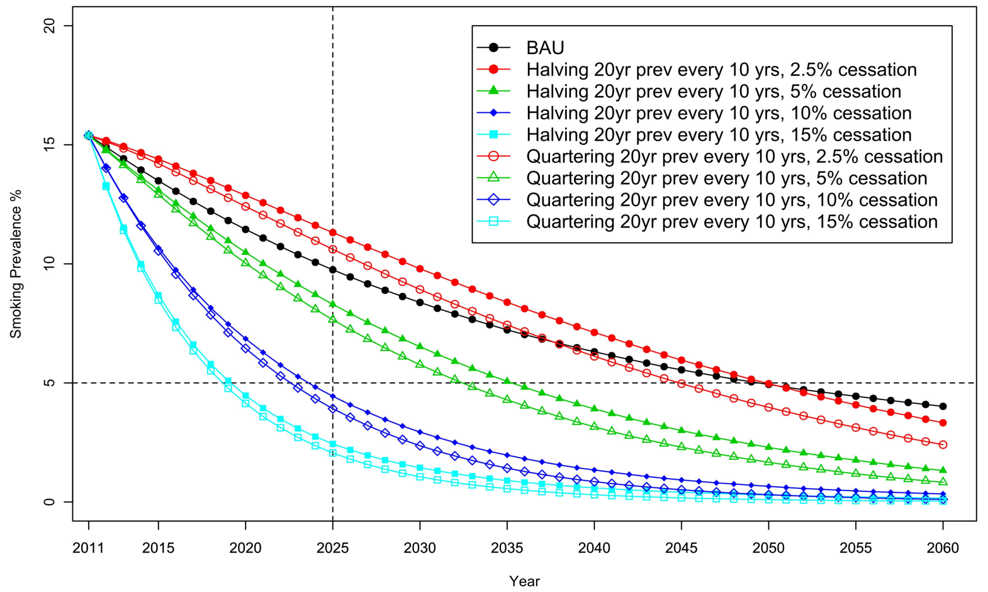
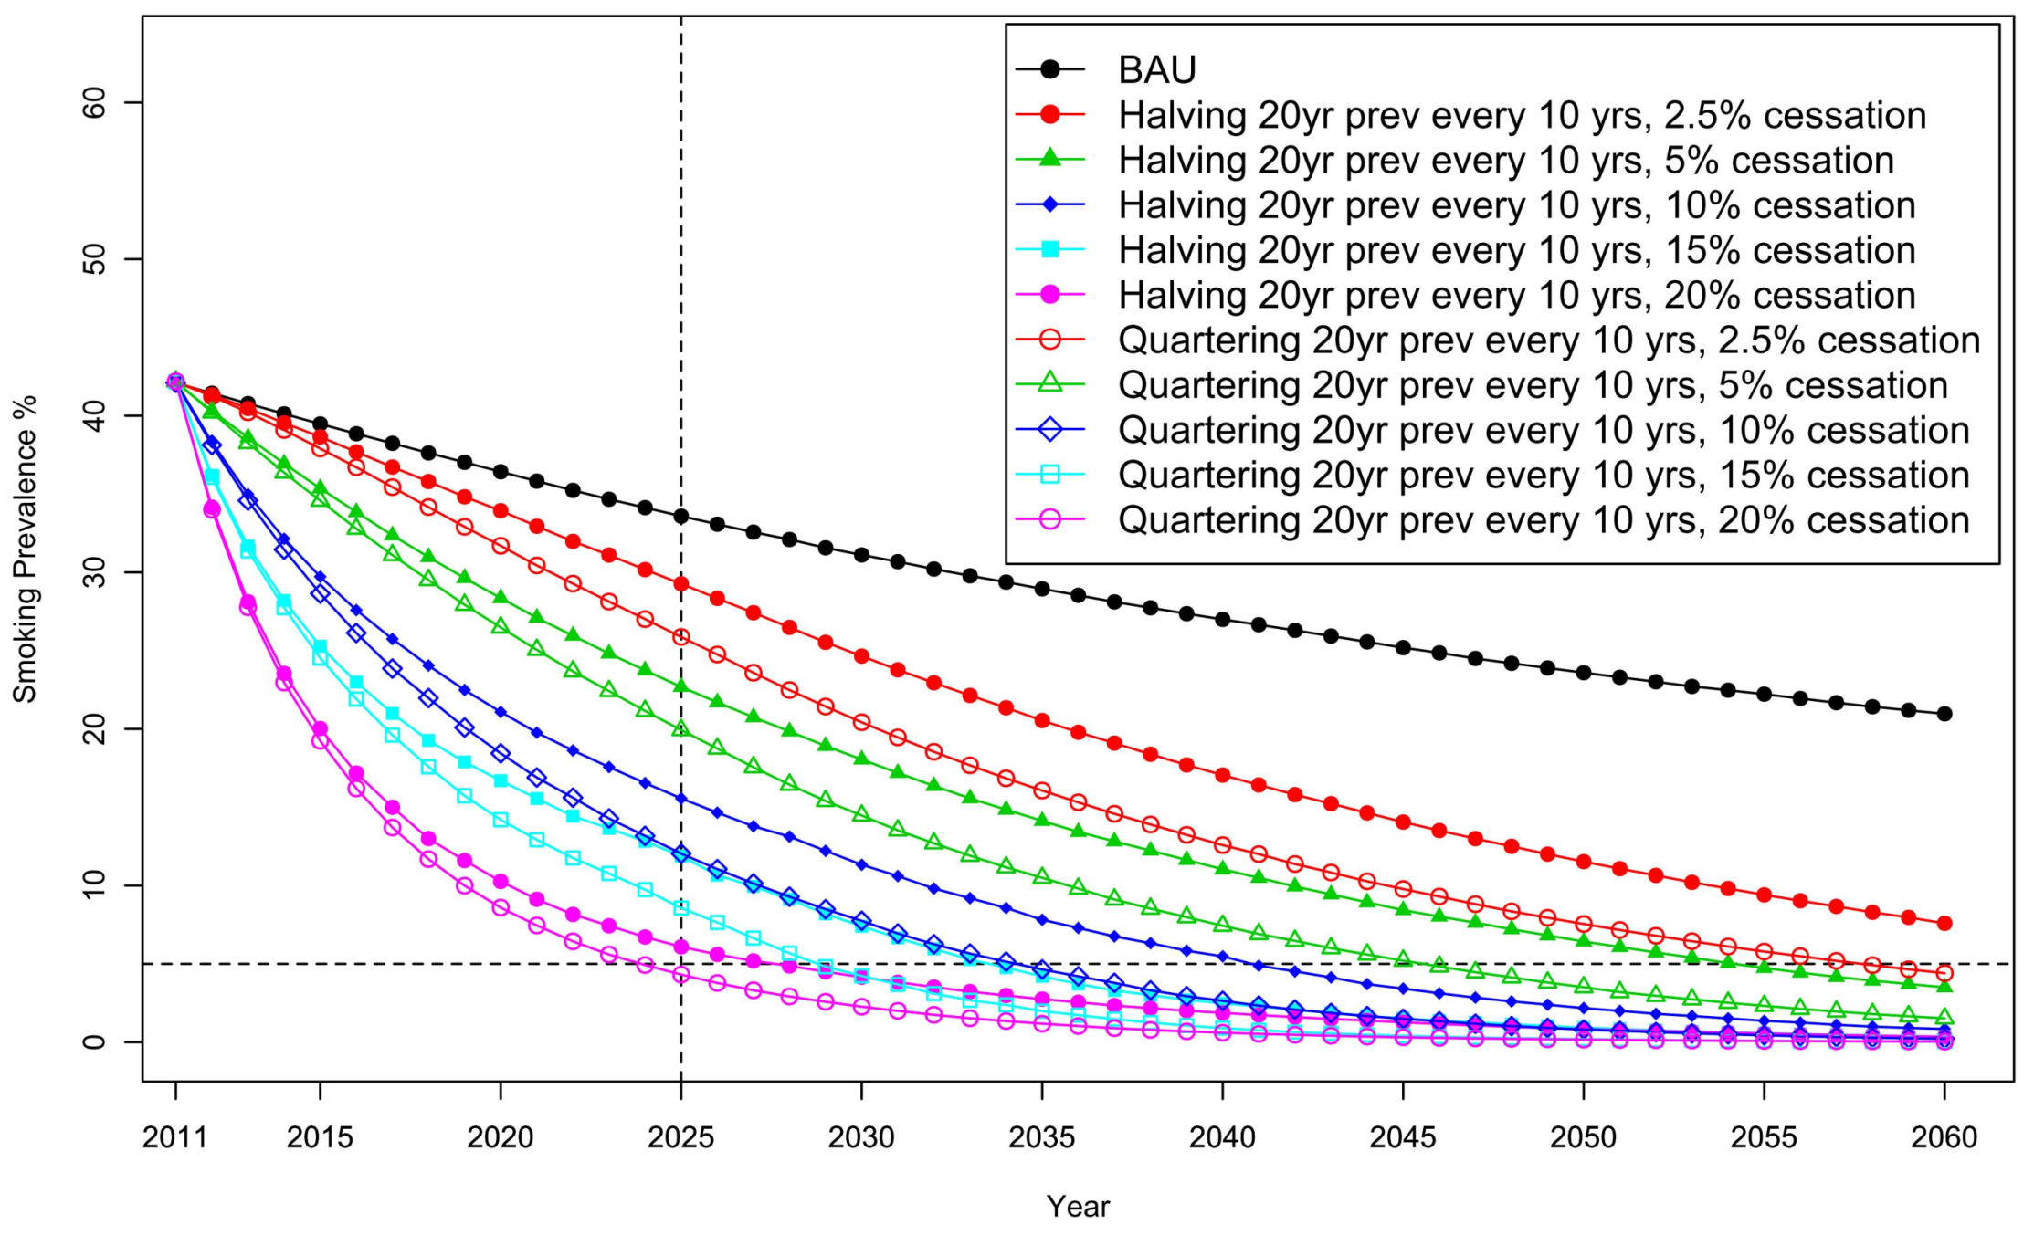
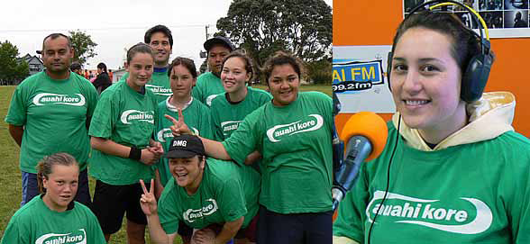
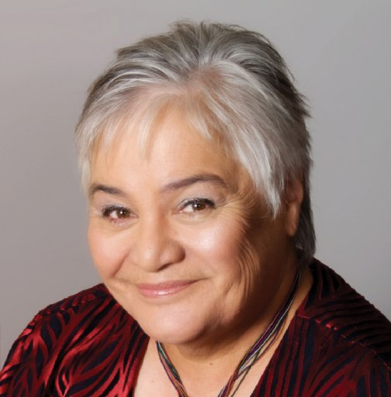
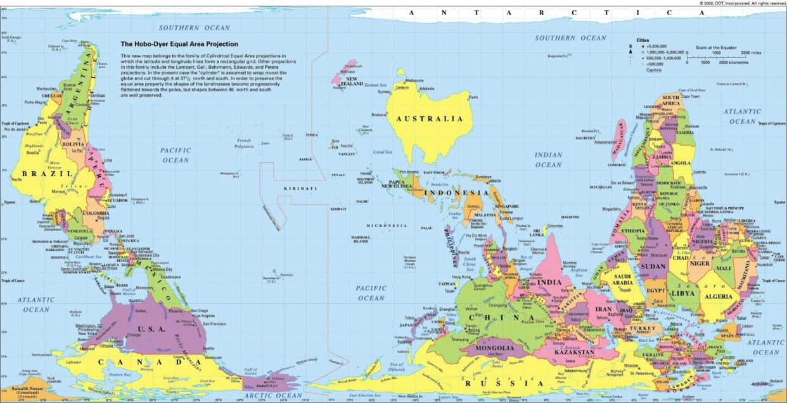
What is Needed to Achieve New Zealand’s Smokefree Nation Goal: Results from a Forecasting Model
Takayoshi IKEDA^{*1}, Linda COBIAC^{1,2}, Nhung NGHIEM¹, Kristie CARTER¹, Nick WILSON¹, Tony BLAKELY¹ ¹ Department of Public Health, University of Otago, Wellington, New Zealand
² School of Population Health, University of Queensland, Australia *Presenter, E-mail: tak.ikeda@otago.ac.nz
The 10th Asia Pacific Conference on Tobacco or Health in Chiba, Japan
Introduction
There is growing international interest in ending the tobacco epidemic. In New Zealand (NZ), the Government has a goal of a “Smokefree Nation by 2025”¹ (i.e. <5% smoking prevalence). This is to benefit the health of all NZers but there is a particular need to reduce health inequalities by improving health for the Māori population (indigenous people)².
Daily smoking prevalence in 2012 was 17% in NZ adults, but was over 40% for Māori. Smoking rates are also much higher among socially disadvantaged groups³.
To inform considerations around achieving a smokefree nation goal, our research questions were:
(1) What will the smoking prevalence be in 2025 under current trends?
(2) What annual changes in initiation and net annual cessation rates will be required to achieve <5%?
Fig. 1: Forecast of non-Māori (top) and Māori (bottom) smoking prevalence (sexes combined) for business-as-usual and other scenarios.
Results
Annual net cessation rates ranged from -3.0 to 6.1% across demographic groups.
Under BAU, smoking prevalence by 2025 was 10.7% (9.5-12.1%) and 8.8% (7.8-10.1%) for non-Māori males and females, and 30.0% (25.2-35.6%) and 37.3% (33.2-42.0%) for Māori.
Achieving <5% by 2025 requires net cessation rates of 10% for non-Māori and 20% for Māori with halving or quartering of initiation rates (Fig. 1).
Methods
A dynamic Markov model⁴ was developed using Census and Health Survey data from 1981 to 2012 to calculate changes in initiation by age 20 and net annual cessation rates, by sex, age, ethnic group and epoch. The following are the modelling steps:
Establish recent trends with the ‘base model’.
Use outputs from (1) for the most recent epoch as inputs in the ‘forecasting model’ for future business-as-usual (BAU) projections.
Fig. 2: Promoting “auahi kore” (smokefree in Māori language)
Discussion
Achieving <5% smoking prevalence by 2025 appears feasible but will require sizeable increases in cessation among non-Māori (to ~10% per annum), and large increases for Māori (to ~20% per annum), in both instances accompanied by strong reductions in initiation.
This will require continued well-established evidence-based tobacco control interventions (e.g. continuing the current pattern of annual tobacco tax increases), as well as supplementary interventions for population groups with highest smoking rates (e.g. intensive mass media campaigns, enhancing intensive smoking cessation support that is both targeted and culturally appropriate (Fig. 2)). For countries with indigenous politicians, it will be important that they are also key leaders in tobacco control policy at the national and local-level. As per such leadership in NZ, see Fig. 3.
Major new endgame approaches may also need to be adopted, such as:
a sinking lid on tobacco supply
a phase-down of nicotine levels in tobacco
a smoker’s licensing system
A Markov process was used to estimate the population counts by sex, age and calendar year post-1981, parameterised in terms of annual (smoking-specific) mortality rates and annual cessation (i.e. transition probabilities from current to ex-smoker). The model was then ‘solved’ by optimising the net annual cessation (by sex by 20-34, 35-54 and 55+ year age-groups, and three time periods 1981-1992, 1993-2001, 2002-2011) that minimised the squared difference in estimated population size compared to census population counts and census/survey smoking prevalence (with the survey estimates weighted by the inverse of their variance). Uncertainty in annual cessation rates (i.e. 95% uncertainty intervals) were estimated with Monte Carlo simulation, as described by Gartner et al⁴, using the Ersatz add-in (www.epigear.com). Sensitivity analyses were done to compare similar parameters obtained from a panel study.
Conclusions
While the smokefree goal (<5% by 2025) appears feasible for NZ, greatly increased cessation rates would be required, particularly for Māori. Intensified established tobacco control interventions such as higher tobacco taxes will definitely be needed, possibly along with major endgame strategies.
References 1. Government Response to the Report of the Māori Affairs Committee on its Inquiry into the tobacco industry in Aotearoa and the consequences of tobacco use for Māori (Final Response). Wellington: NZ Parliament, 2011. 2. Blakely et al. N Z Med J 2010; 123(1320): 26-36. 3. The Health of NZ Adults 2011/12: Key findings of the NZ Health Survey. Wellington: Ministry of Health, 2012. 4. Gartner et al. Tobacco Control 2009; 18(3): 183-89.
Fig. 3: Tariana Turia, Associate Minister of Health & Māori Party Leader
Acknowledgements and Funding: Jan Barendregt provided advice on the dynamic model. The authors are supported by the BODE³ Programme which is studying the effectiveness and cost-effectiveness of various tobacco control strategies and receives funding support from the Health Research Council of New Zealand (Project number 10/248). The UOW Continuing Education Fund covered travel costs and conference fee.

