Slide 1
The New Zealand tobacco tax increases – are they still having an impact? Findings from the 2016-18 ITC New Zealand Surveys
Richard Edwards, James Stanley, Maddie White,
Andrew Waa, Susan C Kaai, Anne C K Quah, Geoffrey T Fong
Notes:
Background
E-cigarettes (ECs) have potential to help achieve Smokefree Aotearoa
Limited information on patterns of use of ECs from population based surveys
Response to liberalisation of availability of ECs since 2017 uncertain - Increase in EC availability due to lax enforcement and the impact of a Mar 2018 court judgement which had the effect of liberalising retail sales. Pre-2017, ECs and e-liquids with nicotine prohibited for sale in NZ. From Mar 2017, ECs increasingly available from vape stores and other retail outlets

Slide 2
ITC New Zealand Project
NZ Team
Richard Edwards ¹
Anaru Waa ¹
James Stanley ¹
Andrea Farquharson ¹
Maddie White ¹
University of Waterloo team
Susan C Kaai
Anne C K Quah
Geoffrey T Fong
Acknowledgements
Health Research Council of New Zealand
Ministry of Health NZHS team
Research NZ
Other ITC Project teams and investigators
Advisory Group
El-Shadan Tautolo ³
Janet Hoek ¹ ²
Phil Gendall ²
Heather Gifford ⁴
1. Department of Public health, University of Otago, Wellington
2. Department of Marketing, University of Otago, Dunedin
3. Centre for Pacific Health & Development Research, Auckland University of Technology
4. Whakauae Research for Māori Health and Development, Whanganui
Mary Thompson, Mi Yan and other members of Waterloo ITC data management team
Notes:
Mi Yan did data cleaning

Slide 3
Background
Regular above inflation tobacco excise increases since 2010
Increasing debate about justification for further increases
NZ Govt delayed decision on implementing 2020 increase and commissioned independent (EY) report
Concerns included:
Reducing impact in promoting quitting
Increasing adverse financial impacts, especially on disadvantaged groups
Other possible adverse effects e.g.
Increases in retail robberies involving theft of cigarettes
Increase in illicit trade

Slide 4
Aim
Explore impact of recent NZ tobacco tax increases on smokers

Slide 5
Methods
Data from the ITC New Zealand study
Recruitment from national survey (NZHS)
Analysis of CATI survey data among smokers from Wave 1 (W1) Sept 2016 – Apr 2017 (n = 910, 326 Māori) and Wave 2 (W2) Jul-Dec 2018 (n = 726, 308 Māori)
Repeat cross-sectional analysis (within cohort analysis not presented)
Analysis allows for over-sampling and other complexities of sample structure
Notes:
Cohort recruited from national health survey (NZHS)
Response – W1 41.5% of all contacted eligible subjects from NZHS, 27.6% among all eligible subjects
From James: Analysis accounts for over-sampling of some participant groups in the NZHS/ITC sampling stages” (and also incorporates other complex sampling elements into inferential statistics i.e. confidence intervals for these outputs)
NZHS info
NZHS = continuous cross-sectional survey run by MoH
Nationally representative sampling frame, 80% response
85% of participants agree to re-contact for further research
Annualised sample of 12-12500, estimate yields potential sample of 2500-3000 smokers and recent quitters
Allows for efficient ITC sample recruitment, info on non-responders, source for replenishment and additional data through linkage - allows additional analyses in NZ arm e.g. linking change in beliefs and behaviours to:
Household composition & detailed socio-economic status
Physical and mental health (including presence of smoking-related conditions)
Alcohol use
Health care utilisation
Experience of racism and discrimination
Māori sample
Around 35% of cohort, large numbers allows separate analysis of Māori sample with substantial explanatory power
Opportunity to address issues of specific interest to Māori eg:
Māori attitudes to policies and smokefree 2025 goal
Differential impact of interventions and policies on Māori
Influence of family/whanau on quitting behaviour
Unique as other ITC arms do not have over-sampling and have only small numbers of indigenous peoples

Slide 6
Comparisons
W1 vs W2
Ethnicity - Māori / Non-Māori
Disadvantage (financial stress Y / N)
shortage of money to pay bills in last 30 days
&/or
unable to buy essentials due to expenditure on cigarettes in last 6 months
Notes:
In the last 30 days, because of a shortage of money, were you unable to pay any important bills on time, such as electricity, telephone or rent bills?
Yes 2 No
In the last 6 months, has there been a time when the money you spent on cigarettes or tobacco resulted in not having enough money for household essentials such as food?
1 Yes 2 No

Slide 7
Outcome measures
Indicators of:
price sensitivity (4 indicators)
price impact on smoking related attitudes and behaviours (5 indicators)
financial stress (2 indicators)

Slide 8
Price sensitivity (W1 + W2)
Notes:
High proportion had each indicator of sensitivity. Most had ≥ 2.
Increase in % choosing brand partly due to price and in % with all 4 indicators of sensitivity from W1 to W2.
Qs
Among smokers who stated a brand that they usually smoked.
In choosing to smoke was part of your decision to smoke this brand based on any of the following - Price (Yes/No)
Compared to 12 months ago, do you think that your cigarettes are better value, worse value, or about the same value?
What do you think about the amount of tax on tobacco products?
It is far too high 2 It is a bit too high 3 It is just right 4 It is a bit too low 5 It is far too low
If you were to quit smoking cigarettes permanently in the next 6 months, do you think your finances would . . . ?
1 Improve a lot 2 Improve a little 3 Stay the same 4 Become a little worse

Slide 9
Price sensitivity by disadvantage (W1 + W2)
Notes:
Disadvantaged in both waves more likely to choose brand on price. Otherwise not much difference.
Data not shown - Māori less likely to choose brand based on price (59 vs 69% W2); increase in choosing brand on price among non-Māori (54% W1, 69% W2) and in % of Māori considering cigs worse value (52%W1, 78% W2). Otherwise not much difference M vs NM.
Qs
Among smokers who stated a brand that they usually smoked.
In choosing to smoke was part of your decision to smoke this brand based on any of the following - Price (Yes/No)
Compared to 12 months ago, do you think that your cigarettes are better value, worse value, or about the same value?
What do you think about the amount of tax on tobacco products?
It is far too high 2 It is a bit too high 3 It is just right 4 It is a bit too low 5 It is far too low
If you were to quit smoking cigarettes permanently in the next 6 months, do you think your finances would . . . ?
1 Improve a lot 2 Improve a little 3 Stay the same 4 Become a little worse

Slide 10
Price impact (W1 + W2)
Notes:
Majority thought about money spent on smoking often or very often. Around reported attest tax increase had made them think about quitting. Small decreases in quitting impact in W2 (note % stating that price of cigs made think about quitting somewhat or very much was 75% W1, 77% W2)
Note that majority and increasing gave as a reasons for using ECs that it is cheaper than smoking.
Qs
In the last 30 days how often, if at all, did you think about the money you spend on smoking? Never, Rarely, Sometimes, Often, Very Often
The tax on cigarettes (both tailor-made and roll-your-own) increased on January 1 this year. Did this increase in tax made you think about quitting smoking? (Y/N)
In the past 6 months, have any of the following things led you to think about quitting -- not at all, somewhat, or very much? The price of cigarettes?
Has this increase in tax reduced or increased the number of cigarettes (either tailor-made or roll-your-own) that you smoke?
Reduced 2 No change 3 Increased
Which of the following are, or were, reasons for your use of e-cigarettes or vaping devices?
You save money by using e-cigarettes or vaping devices instead of smoking. (Y/N)

Slide 11
Price impact by ethnicity (W2)
Notes:
Most;y similar. % stating that price of cigs made think about quitting very much greater in Māori (44% vs 35%), but slightly less Māori gave ECs being cheaper as a reason for using Ecs (74% vs 83%).
Qs
In the last 30 days how often, if at all, did you think about the money you spend on smoking? Never, Rarely, Sometimes, Often, Very Often
The tax on cigarettes (both tailor-made and roll-your-own) increased on January 1 this year. Did this increase in tax made you think about quitting smoking? (Y/N)
In the past 6 months, have any of the following things led you to think about quitting -- not at all, somewhat, or very much? The price of cigarettes?
Has this increase in tax reduced or increased the number of cigarettes (either tailor-made or roll-your-own) that you smoke?
Reduced 2 No change 3 Increased
Which of the following are, or were, reasons for your use of e-cigarettes or vaping devices?
You save money by using e-cigarettes or vaping devices instead of smoking. (Y/N)

Slide 12
Price impact by disadvantage (W2)
Notes:
All price impacts greater among disadvantaged, though differences smaller other than larger % (80% vs 60%) thought about money spent on smoking often or very often.
Note % stating that price of cigs made think about quitting somewhat or very much among disadvantaged was very high (86% W1, 88% W2)
Qs
In the last 30 days how often, if at all, did you think about the money you spend on smoking? Never, Rarely, Sometimes, Often, Very Often
The tax on cigarettes (both tailor-made and roll-your-own) increased on January 1 this year. Did this increase in tax made you think about quitting smoking? (Y/N)
In the past 6 months, have any of the following things led you to think about quitting -- not at all, somewhat, or very much? The price of cigarettes?
Has this increase in tax reduced or increased the number of cigarettes (either tailor-made or roll-your-own) that you smoke?
Reduced 2 No change 3 Increased
Which of the following are, or were, reasons for your use of e-cigarettes or vaping devices?
You save money by using e-cigarettes or vaping devices instead of smoking. (Y/N)

Slide 13
Impact on financial stress by ethnicity (W1 +W2)
Notes:
Financial stress higher among Māori, but no evidence of change between W1 and W2. More specific measure actually fell slightly among M and NM.
Qs
In the last 30 days, because of a shortage of money, were you unable to pay any important bills on time, such as electricity, telephone or rent bills? (Y/N)
In the last 6 months, has there been a time when the money you spent on cigarettes or tobacco resulted in not having enough money for household essentials such as food? (Y/N)

Slide 14
Summary/Implications
Price sensitivity high among smokers and changed little from 2016/17 to 2018
Impact on motivating quitting may have decreased slightly, but remained substantial
similar among Māori and non-Māori
greater impact on disadvantaged
Evidence that cost = important driver to EC use
No evidence of increase in financial stress
Findings support continuing impact of tax increases and no increase in adverse effects

Slide 15
EY Report (Nov 2018)
“Tax increases are an essential part of a package of interventions needed to reduce tobacco consumption and daily smoking prevalence.”
Recommendations
Continue tobacco excise increases to 2020 & beyond
…. if monitoring of effectiveness and adverse effects
…. as part of comprehensive tobacco control action plan/strategy
Complementary measures
access to comprehensive cessation support services
targeted messaging to promote quitting
minimum price to counter industry efforts
Hypothecate (linkage) tax revenue for tobacco control measures
https://blogs.otago.ac.nz/pubhealthexpert/2019/01/24/
Notes:
Govt considering its response
NB Sector not all convinced

Slide 16
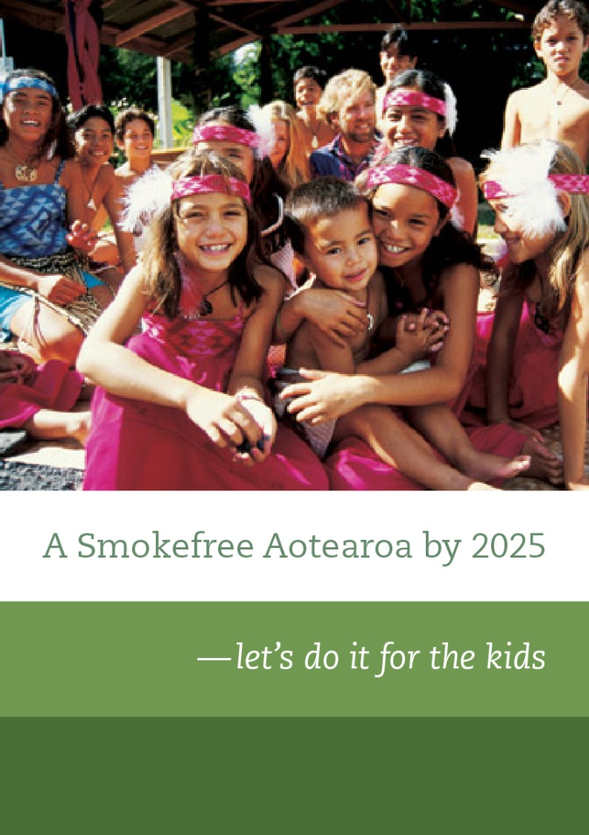
Kia ora
Thank you
richard.edwards@otago.ac.nz
www.aspire2025.org.nz
@ASPIRE2025

