Slide 1
Patterns of use of e-cigarettes among smokers: findings from the 2016-2018 ITC New Zealand Surveys
Richard Edwards, James Stanley, Maddie White,
Andrew Waa, Susan C Kaai, Anne C K Quah, Geoffrey T Fong
Notes:
Background
E-cigarettes (ECs) have potential to help achieve Smokefree Aotearoa
Limited information on patterns of use of ECs from population based surveys
Response to liberalisation of availability of ECs since 2017 uncertain - Increase in EC availability due to lax enforcement and the impact of a Mar 2018 court judgement which had the effect of liberalising retail sales. Pre-2017, ECs and e-liquids with nicotine prohibited for sale in NZ. From Mar 2017, ECs increasingly available from vape stores and other retail outlets

Slide 2
ITC New Zealand Project
NZ Team
Richard Edwards ¹
Anaru Waa ¹
James Stanley ¹
Andrea Farquharson ¹
Maddie White ¹
University of Waterloo team
Susan C Kaai
Anne C K Quah
Geoffrey T Fong
Acknowledgements
Health Research Council of New Zealand
Ministry of Health NZHS team
Research NZ
Other ITC Project teams and investigators
Advisory Group
El-Shadan Tautolo ³
Janet Hoek ¹ ²
Phil Gendall ²
Heather Gifford ⁴
1. Department of Public health, University of Otago, Wellington
2. Department of Marketing, University of Otago, Dunedin
3. Centre for Pacific Health & Development Research, Auckland University of Technology
4. Whakauae Research for Māori Health and Development, Whanganui
Mary Thompson, Mi Yan and other members of Waterloo ITC data management team
Notes:
Mi Yan did data cleaning

Slide 3
ITC New Zealand Project
Aim
Explore awareness, use and reasons for use of ECs among NZ smokers and recent quitters
Methods
Recruitment of smokers and recent quitters (< 1 year) from national survey (NZHS)
Analysis of CATI survey data from Wave 1 (W1) Sept 2016 – Apr 2017 (n = 1086) and Wave 2 (W2) Jul-Dec 2018 (n = 1020)
Repeat cross-sectional analysis
Notes:
Cohort recruited from national health survey (NZHS)
Response – W1 41.5% of all contacted eligible subjects from NZHS, 27.6% among all eligible subjects
From James: Analysis accounts for over-sampling of some participant groups in the NZHS/ITC sampling stages” (and also incorporates other complex sampling elements into inferential statistics i.e. confidence intervals for these outputs)
NZHS info
NZHS = continuous cross-sectional survey run by MoH
Nationally representative sampling frame, 80% response
85% of participants agree to re-contact for further research
Annualised sample of 12-12500, estimate yields potential sample of 2500-3000 smokers and recent quitters
Allows for efficient ITC sample recruitment, info on non-responders, source for replenishment and additional data through linkage - allows additional analyses in NZ arm e.g. linking change in beliefs and behaviours to:
Household composition & detailed socio-economic status
Physical and mental health (including presence of smoking-related conditions)
Alcohol use
Health care utilisation
Experience of racism and discrimination
Māori sample
Around 35% of cohort, large numbers allows separate analysis of Māori sample with substantial explanatory power
Opportunity to address issues of specific interest to Māori eg:
Māori attitudes to policies and smokefree 2025 goal
Differential impact of interventions and policies on Māori
Influence of family/whanau on quitting behaviour
Unique as other ITC arms do not have over-sampling and have only small numbers of indigenous peoples

Slide 4
E-cigarette awareness, trial and current use (W1 + W2)
Notes:
Awareness very high, use increasing – daily from 8% to 12.2%
Qs
Have you ever heard of electronic cigarettes, also called e-cigarettes, vapes, or vaping devices?
1. Yes 2. No
Have you ever used an e-cigarette or vaping device, even one time?
1. Yes 2. No
On average, how often do you CURRENTLY use e-cigarettes or vaping devices?
1 Every day
2 At least once a week, but not every day
3 At least once a month, but not every week
4 Less than monthly
5 Not at all

Slide 5
E-cigarette awareness, trial and current use – by ethnicity (W2)
Notes:
Awareness and use similar Māori and non-Māori – slightly higher ever use

Slide 6
E-cigarette awareness, trial and current use – by smoking status (W2)
Notes:
Daily (22.8 vs 7.9%) and ≥ monthly (30.4 vs 19.6%) use greater among recent quitters

Slide 7
E-cigarette type, place of purchase and use of nicotine containing ECs/e-liquid (W1 + W2, ≥ monthly current EC users)
Notes:
Predominance of generation 3, increased in W2. 80% nicotine containing. Vape shop most common place purchased – increasing W2.
All asked only of at least monthly current EC users
Which of the following best describes the TYPE of e-cigarette or vaping device you [currently use MOST (051/NC08304=1 or 2)/ used LAST (051/NC08304=3)]?
1 It's disposable, not refillable, and non-rechargeable
2 It’s rechargeable and uses replaceable pre-filled cartridges
3 It’s rechargeable and has a tank that you fill with liquids
Does the e-cigarette or e-liquid that you currently use most contain nicotine? OR Did the e-cigarette or e-liquid that you used last contain nicotine?
1 Yes
2 No
Now thinking about the last time you purchased e-liquid, e-cigarette cartridges or disposable e-cigarettes. Where did you make this last purchase?
01 On the internet
02 Vape shop/e-cigarette kiosk
03 Tobacco specialty shop/ tobacconist
04 Newsagent/ bottle-store/ dairy or convenience store
05 [Petrol/ Gas] station shop
06 Supermarket
07 Chemist/ Pharmacy
08 Pub or Bar
09 Other store
10 Independent seller, not a mainstream shop, market stall, pop-up shop
11 Bought abroad and brought back with me
12 Friend or relative
13 Free sample
14 Shared bulk purchase with other people
15 Somewhere else
76 Doesn't remember any details of last purchase

Slide 8
E-cigarette purposes and motivations for use (W2 ≥ monthly current EC users )
Notes:
Difficult to interpret. Most reported using Ecs to quit, but also > ½ not to quit. High % reporting use to cut down also concerning. Losts of drivers./motivators – but note cost very important.
All asked only of at least monthly current EC users
Which of the following are, or were, reasons for your use of e-cigarettes or vaping devices?
As a way to help you quit smoking.
To make it easier to cut down on the number of ordinary cigarettes you smoke.
Replacing some of your ordinary cigarettes with an e-cigarette or vaping device means you don’t have to give up smoking ordinary cigarettes altogether.
Because you can use them in places where smoking ordinary cigarettes is banned.
You save money by using e-cigarettes or vaping devices instead of smoking.
They may not be as bad for your health.
They taste better.
Advice from a health professional.
Using e-cigarettes or vaping devices is less harmful than smoking to other people around you.
Using e-cigarettes or vaping devices is more acceptable than smoking to people around you.
You enjoy using e-cigarettes or vaping devices.

Slide 9
Summary/Implications
Increasing use of ECs, similar for Māori and non-Māori
Encouraging that use is highest among ex-smokers
Vape shops = most important source
May need to emphasise that use of ECs to cut down smoking should only be an interim goal
Emphasis on relative cost may be important to encourage use among smokers

Slide 10
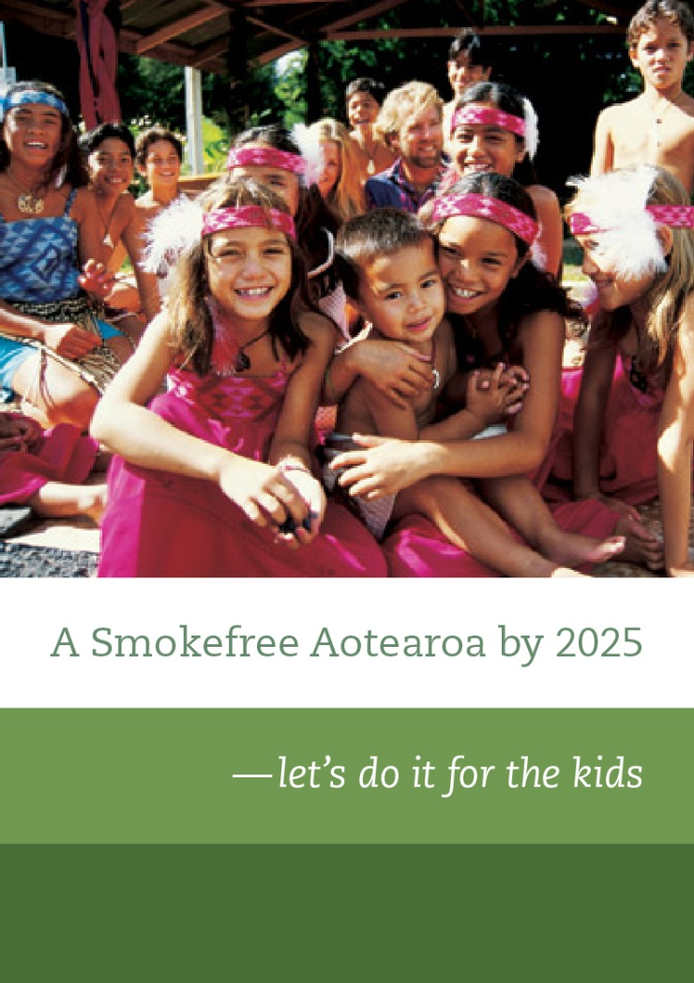
Kia ora
Thank you
richard.edwards@otago.ac.nz
www.aspire2025.org.nz
@ASPIRE2025

