Slide 1
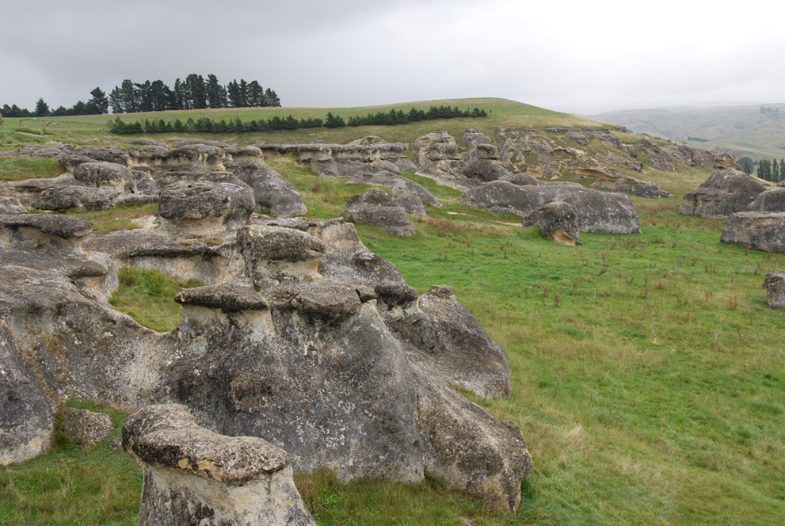
Introduction to Field Geology
Maerewhenua GEOL252 Fieldclass

Slide 2
When and Where?
The field trips take place in February each year
see dates on https://www.otago.ac.nz/geology/study/field-trips/
Domestic and international students intending to take GEOL252 must fill out the Registration form and make payment for food via the link
https://www.otago.ac.nz/geology/study/field-trips/index.html#registration
Please fill out form and make payment as soon as possible but definitely by 31st January

Slide 3
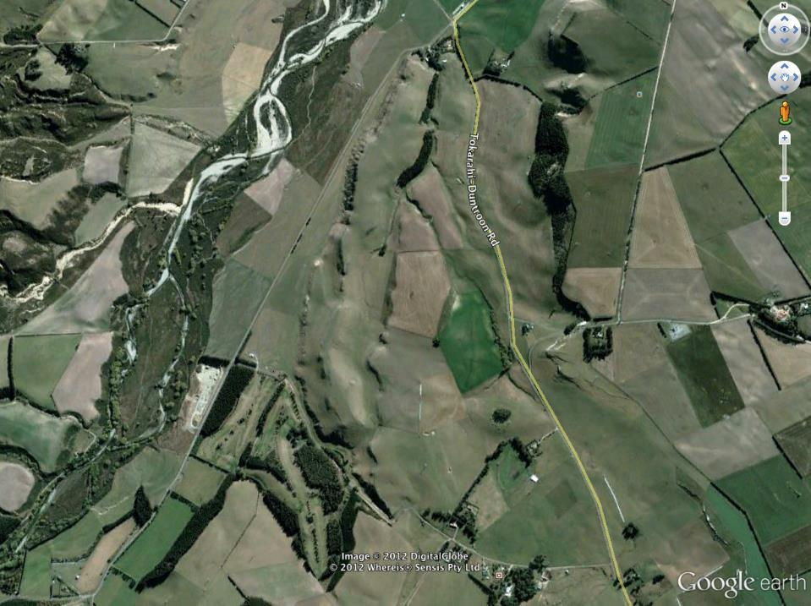
Fly round the area in Google Earth
This will help you with the orientation and safety exercise

Slide 4
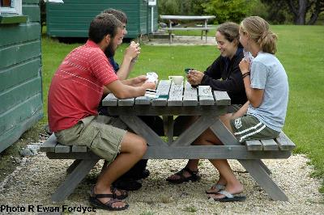
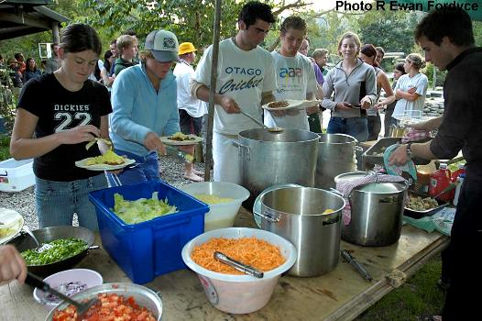
We stay at Dansey’s Pass camp
http://www.danseyspass.com/
Cabins sleep 6-8
If you prefer a tent, let us know and bring your own.
Toilet-shower block
Kitchen-dining area
Lounge
Plenty of flat space outdoors
River, swimming hole

Slide 5
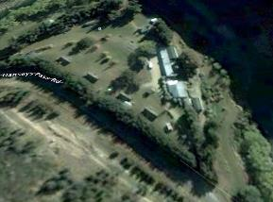
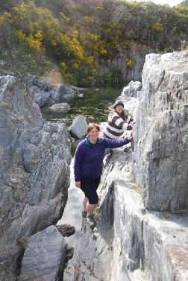
Dansey’s Pass camp
No cellphone coverage
No wireless
No television
No alcohol
You help with the cooking

Slide 6
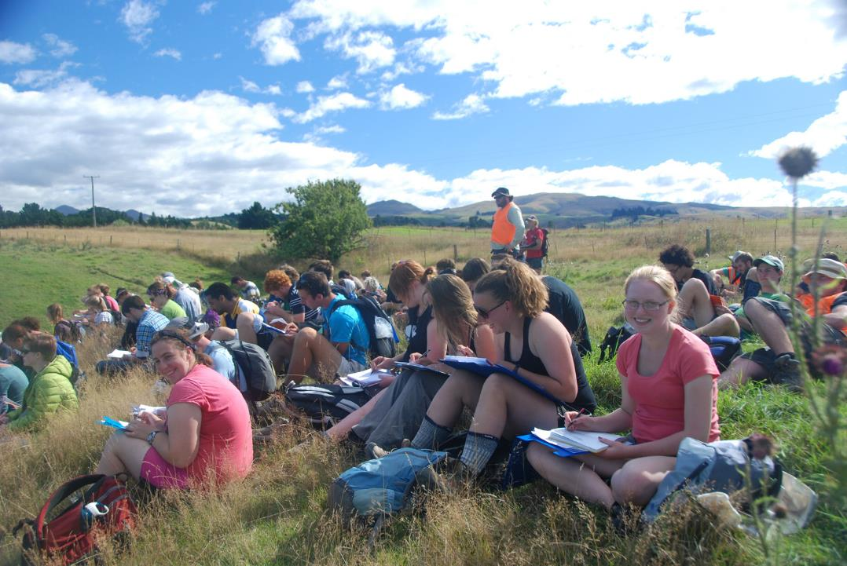
Days in the field: all day, every day, even if it’s raining

Slide 7
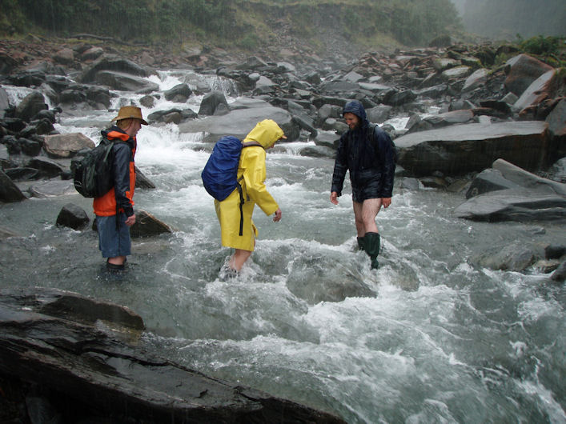
Be Prepared: for anything

Slide 8
What will you learn?
How to make objective, quantitative geological observations
How to record those observations; most particularly how to keep a good field notebook
How to conduct fieldwork in a safe, environmentally friendly and efficient manner.
Some specific field techniques including; sedimentary logging and facies analysis, measuring and recording structural data.
A very basic introduction to geological maps and mapping.
Something of the geology and stratigraphy of the South Island.

Slide 9
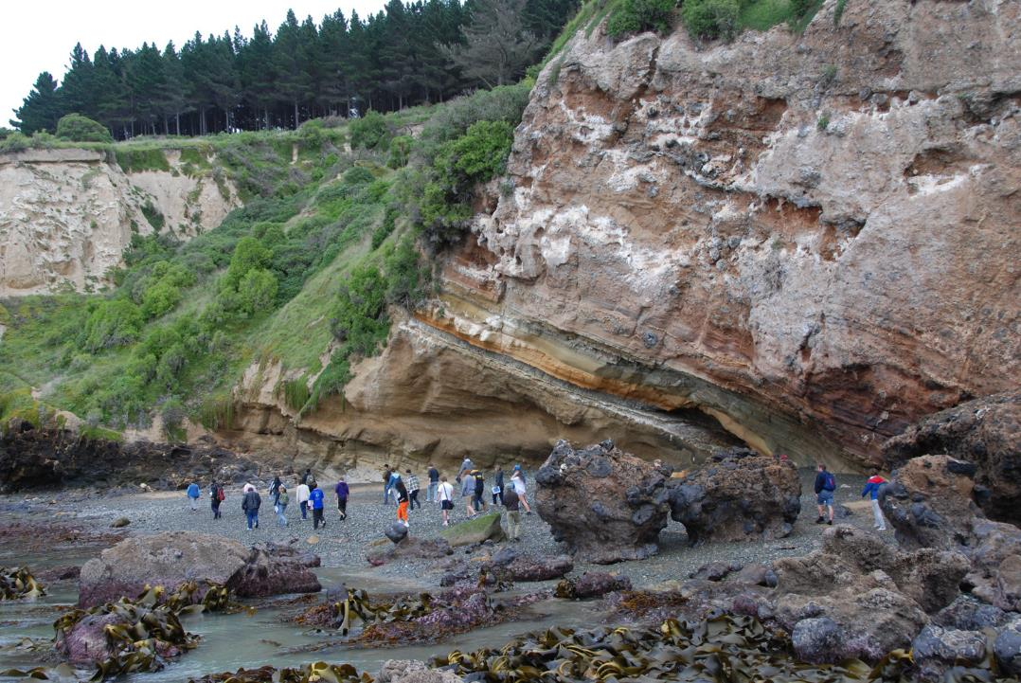
How will you be assessed?
Work collected from the field, before getting back on the bus. Usually this will be marked and returned by the next day.
One to one (with a demonstrator) tests of proficiency whilst in the field.
A short illustrated written description of one of the field localities. This will be done back in Dunedin after some training in writing and illustration.

Slide 10
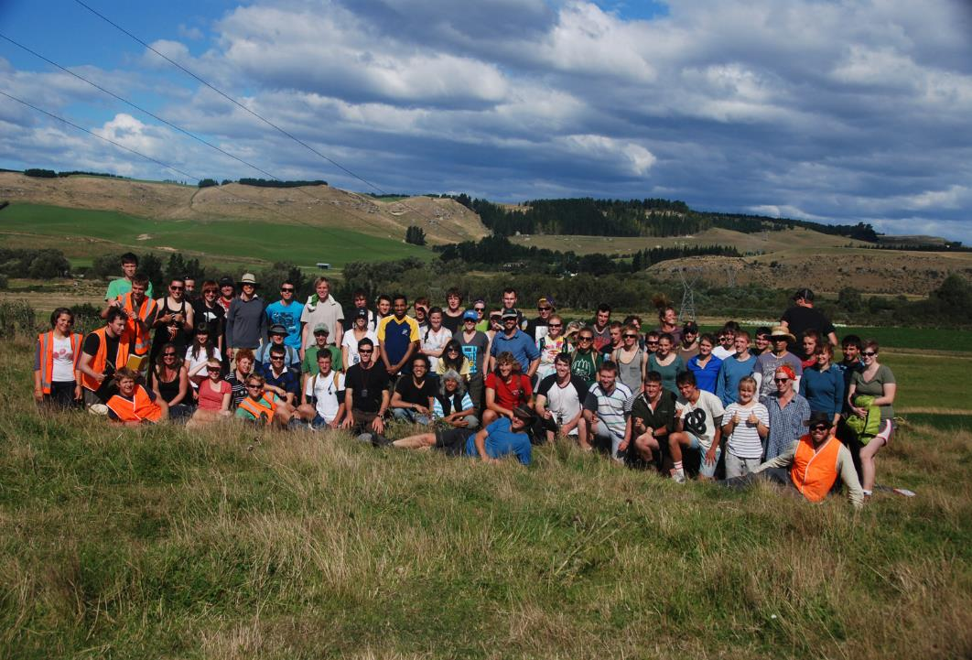
Will you enjoy it? Naturally!
Read on to find out what gear you need to take

Slide 11
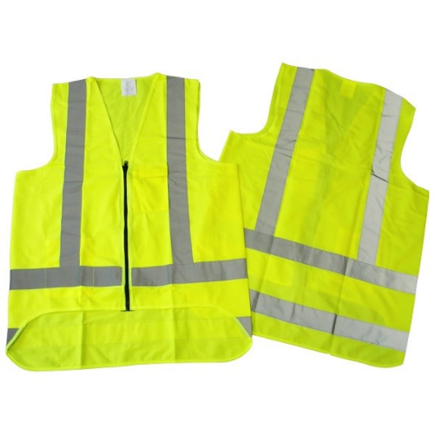
You must have a High vis vest!
Purchase from Road materials (10% geology discount available) or Officemax or somewhere else…

Slide 12
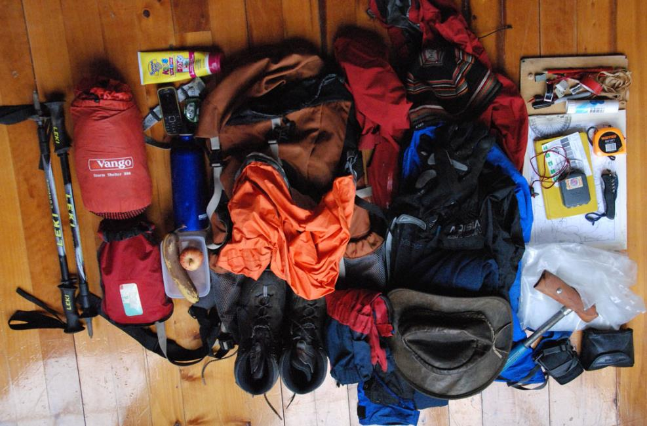
What Dave takes in the field

Slide 13
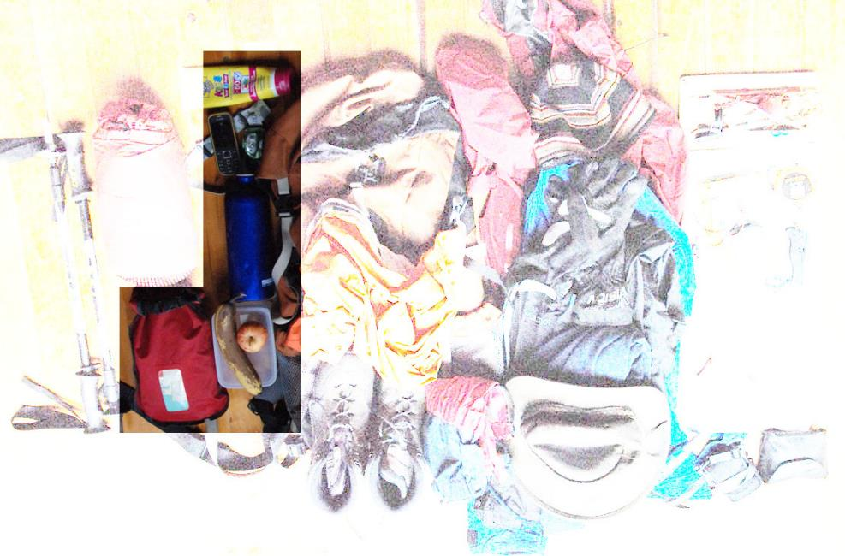
suncream
phone
clock
torch
water
food
First aid kit: appropriate to your level of first aid training
whistle: it’s hidden in the bag!
Stuff you need: safety/ emergencies

Slide 14
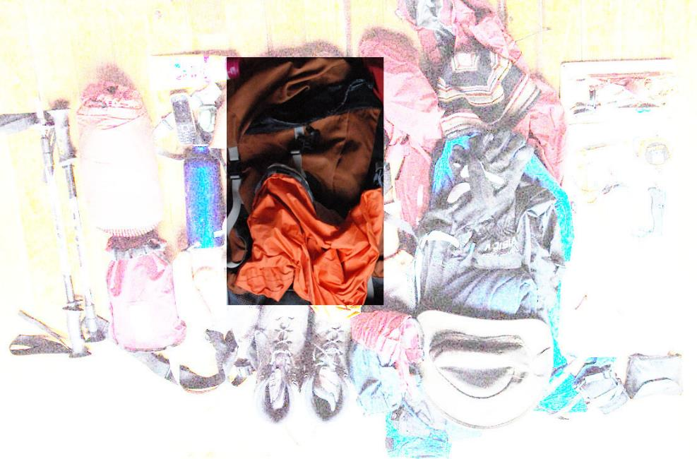
Backpack: big
enough to carry everything
waterproof inner
or cover
Stuff you need: bags

Slide 15
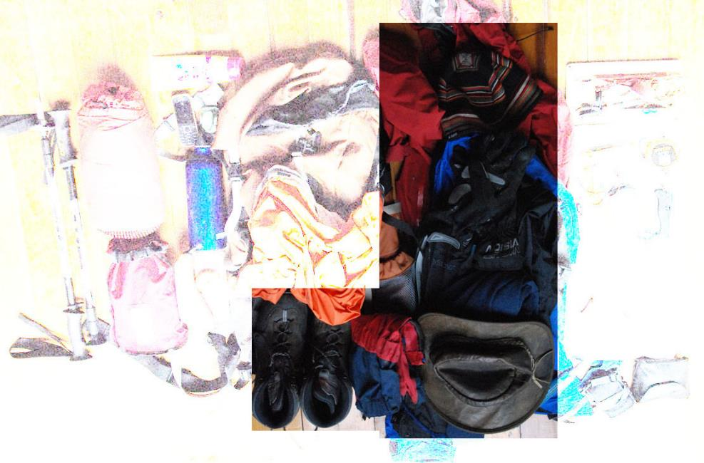
see next slide
Stuff you need: clothes

Slide 16
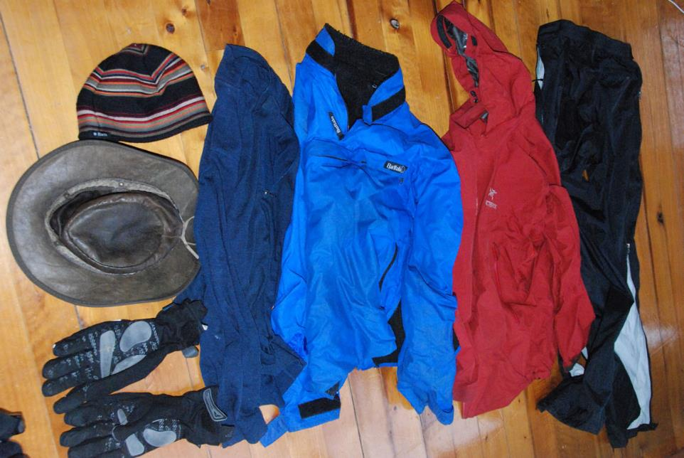
Be ready for hot, cold, wet, sunny..

Slide 17
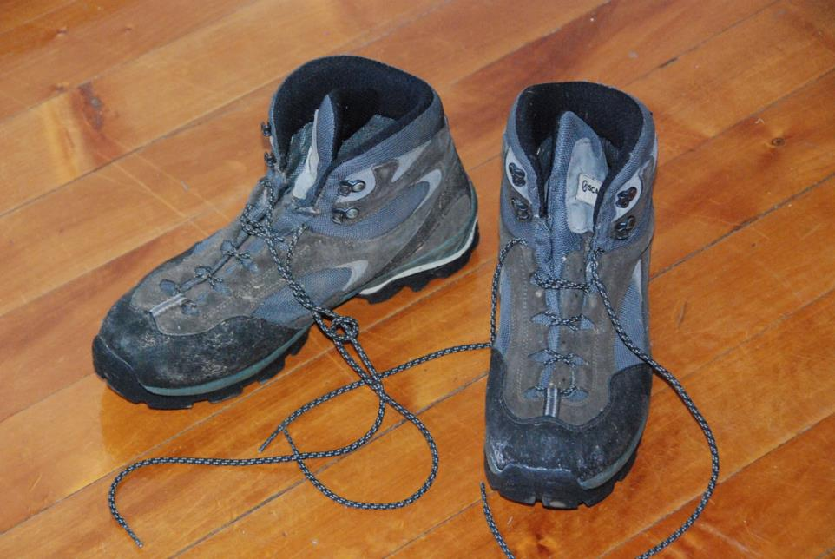
ankle protection
well-fitting:
laced.
covered toes and foot
grippy
soles
suitable footwear

Slide 18
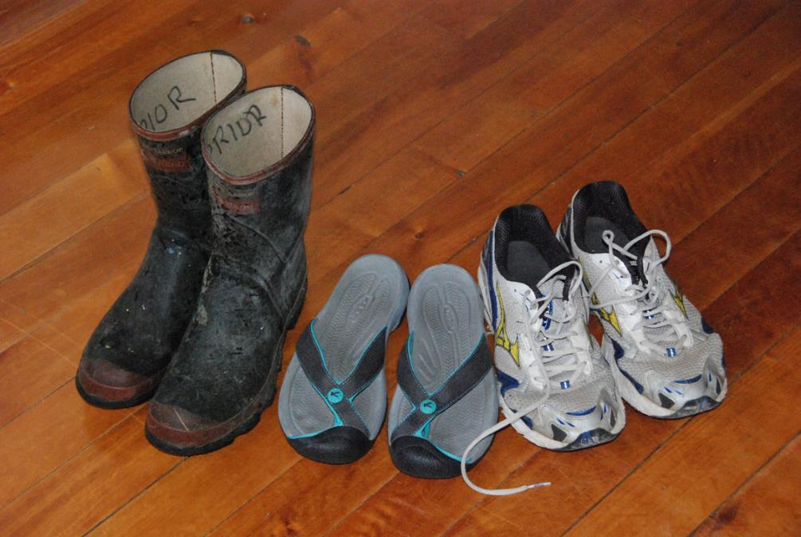
unsuitable footwear

Slide 19
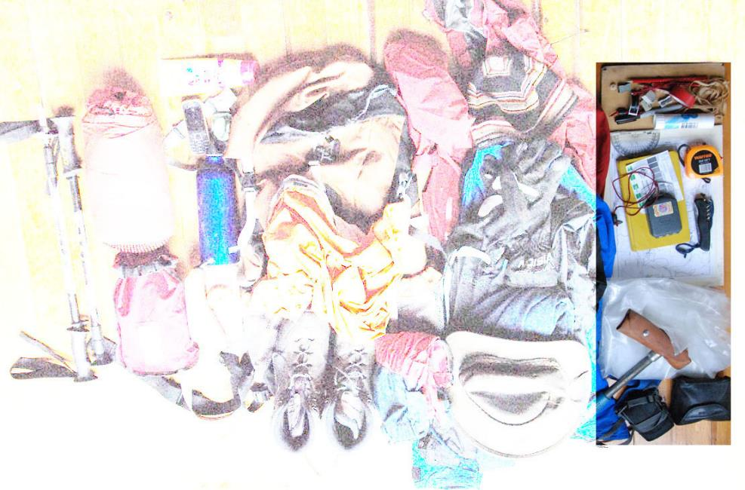
the rest- see next slide
Hammer: students not allowed to bring these to Maerewhenua. There will be hammers and safety goggles you can borrow.
Camera/ Binoculars: not essential but useful
Stuff you need: work gear

Slide 20
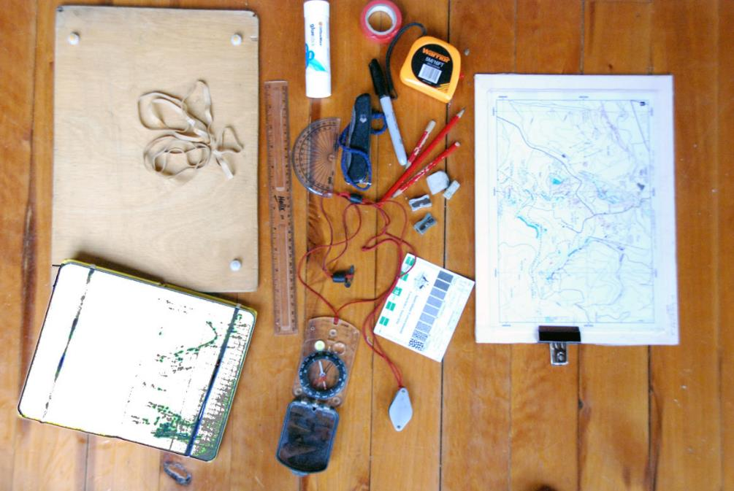
Glue and sticky tape
3m (or longer) tape measure
Elastic bands
30cm ruler
penknife
Pencils (HB and 2H), several of each
and coloured pencils.
protractor
Rubbers and sharpeners
Map board
(provided by Geology Dept)
10x A4 Card (we supply)
Notebook
see later
Grain size comparator:
see next slide
Hand Lens: see next slide
Compass clinometer: see next slide
Stuff you need: work gear

Slide 21
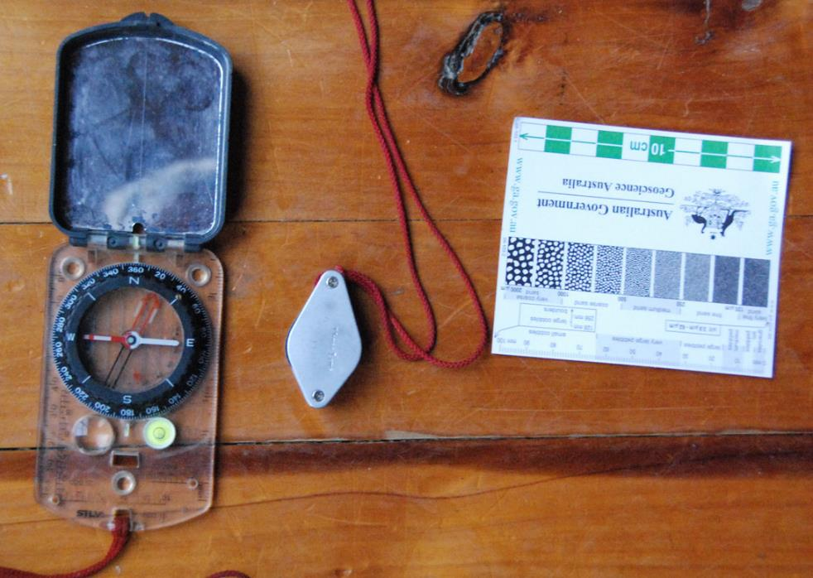
Things to buy from University
Book Shop
every student needs one of each of these.
Hand lens.
Plastic or metal
Grain-size comparator (provided by Geology Dept)
compass – clinometer. Needs to be a southern hemisphere compass. Put your name on it!
Stuff you need: work gear

Slide 22
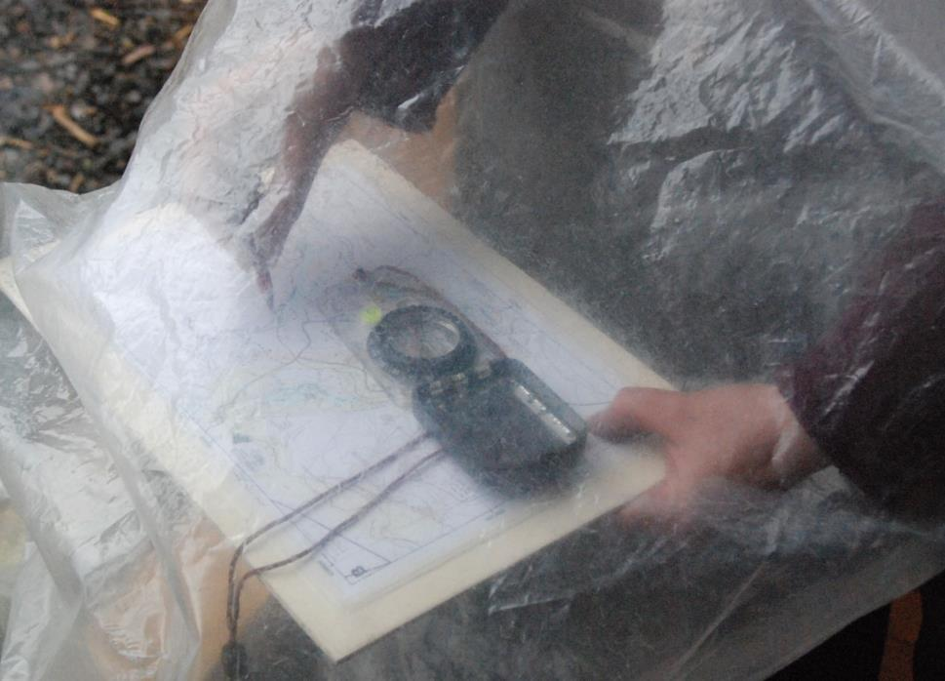
Plastic bag for working in in the rain: heavy duty transparent polythene
We will provide these
Stuff you need: work gear

Slide 23
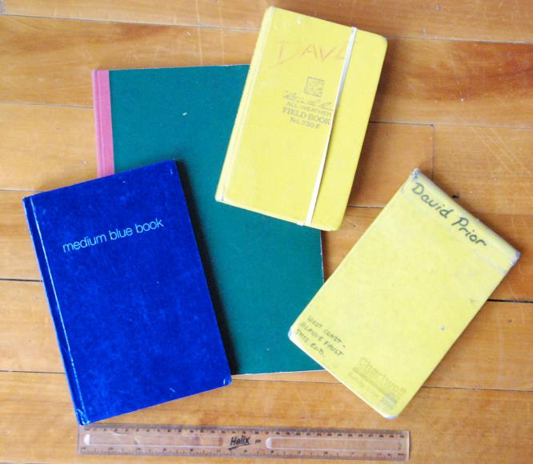
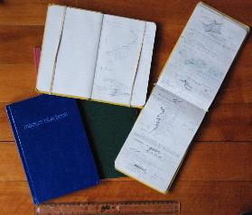
Good Notebooks.
A4 hardback: a few $ from
a stationary store. Some students make better notes with more space but you have to carry it!
*
Professional Field Books. These are the best- but they are expensive
*
This style of book available from University Book Shop.
Notebook also contains various reminder sheets
A5 hardback:
a few $ from
a stationary store
A notebook with graph paper pages is often useful
Stuff you need: work gear

Slide 24
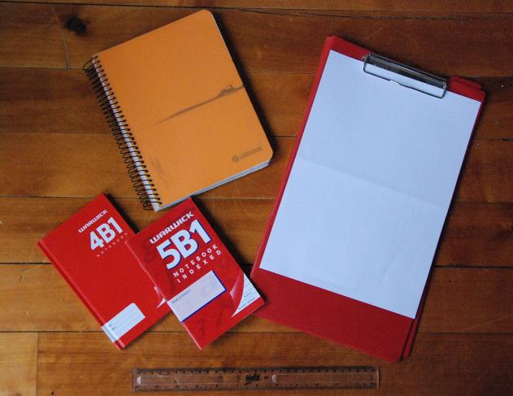
Ring binding means pages will get soaked and notebook will disintegrate
utterly useless will fall apart and you will lose pages
too small
too small and softback
Unsuitable Notebooks

Slide 25
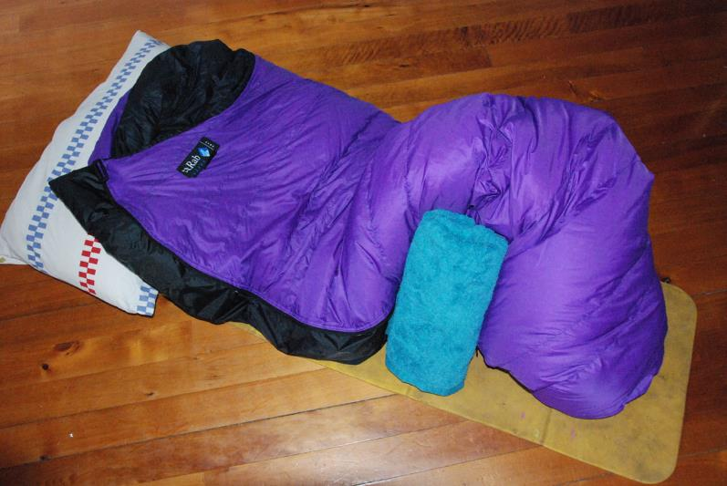
sleeping bag
towel
pillow case or pillow
sleeping mat (if you want to camp)
Stuff you need: camp gear

