Slide 1
Otago Medical School, Educational Development and Staff Support Unit
Giving feedback beyond the task
Online Professional Development Series
Facilitators: Joy Rudland, Kayla Young
Co-facilitators: Dale Sheehan, Tehmina Gladman, Louise Beckingsale
June 2024

Slide 2
Karakia Timatanga
Tuia mai i runga Fasten everything above
Tuia mai i raro Secure everything below
Tuia mai i roto Connect everything within
Tuia mai waho Bind everything without
Kia tau ki a tatou katoa Anchor and connect
Haumi e, hui e Draw it together, gather it . .
Taiki E! Let it be so.

Slide 3

Outcomes
To consider the role of feedback to enhance self (learner) development
Format
Whole group - introduction
Potted history (chat)
Break-out group – main activity
Whole group – feedback
Chat
Summary

Slide 4
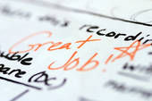
Feedback and learning
Notes:
Being here today you are all perhaps well aware of the importance of feedback to learning.

Slide 5
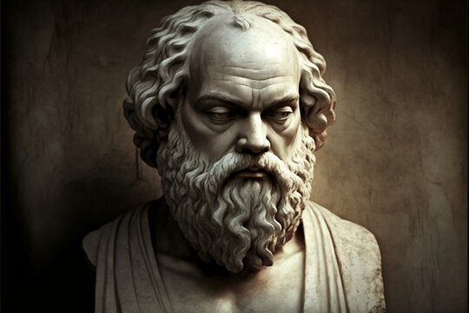
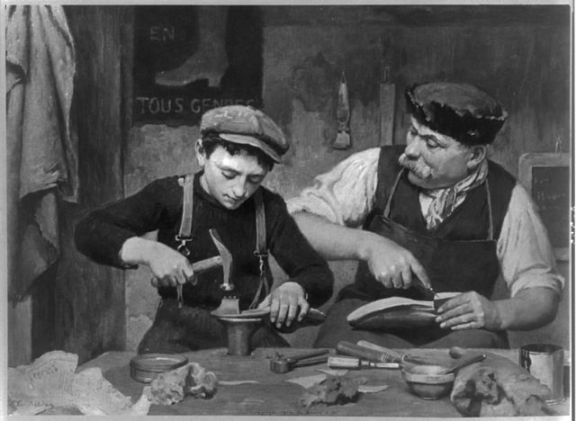
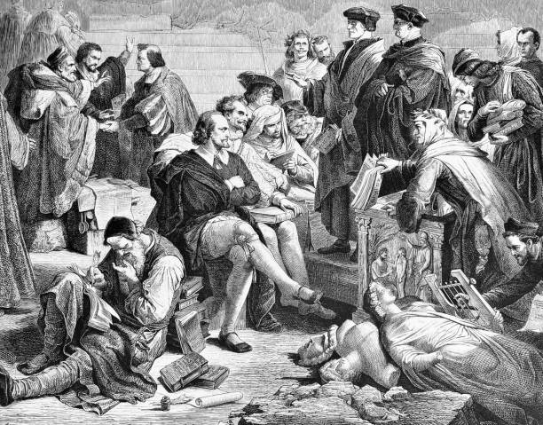
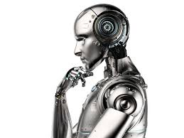
Potted history – General
Ancient times – oral traditions
Socrates - questioning
Renaissance
The apprenticeship model
Enlightenment
Precursor for Scientific thinking – evidence based
Future

Slide 6
Potted history – specific
"WE ARE training a group of physicians who have never been observed,”
1983 Feedback in Clinical Medical Education - outlining principles
1990 plus Models, processes, to assist in giving feedback

Slide 7
Example scenario
You ask a senior student, final year, to examine the abdomen. This is in a clinic with 2 other students. The technique used is well below expectations at this level. The patient leaves and there is an opportunity to give feedback.
What process do you follow to ensure that the student is aware of the correct technique?
Put ideas in the chat or raise your hand

Slide 8
Potted history – specific
"WE ARE training a group of physicians who have never been observed,”
1983 Feedback in Clinical Medical Education - outlining principles
1990 Models to assist in giving feedback
Feedback Sandwich
SET-GO model
Pendleton Model
ALOBA model
One-Minute Preceptor
R2C2(Rapport/Reaction/Content/Coach)

Slide 9
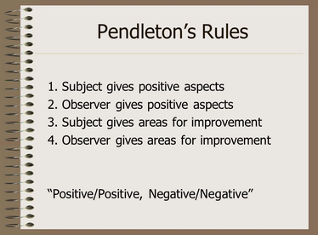
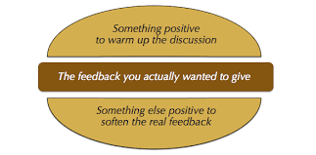
Process to offer feedback on Task
Pendletons, feedback sandwich etc

Slide 10
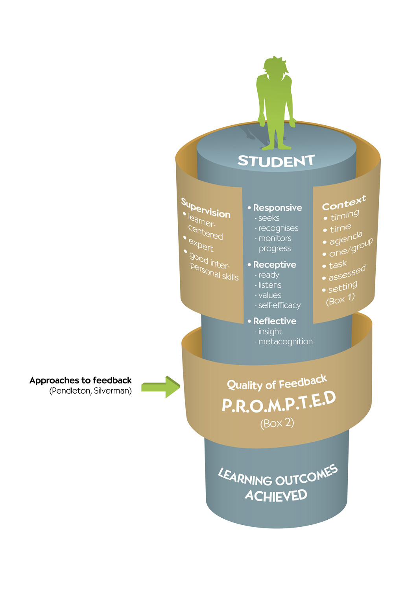
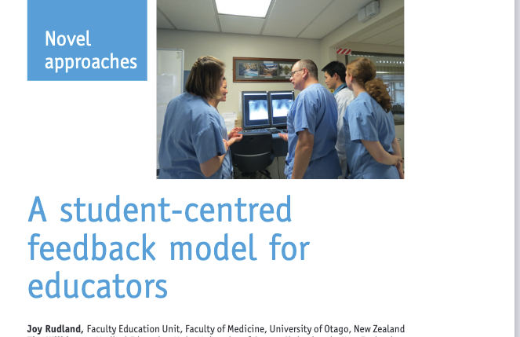
Seduced by the simplicity of task-based feedback
Notes:
In 2012 we generated and presented a model in clinical teaching looking at feedback. This model placed the learning at the centre of the process. The model was promoting Endes concept of feedback as adance.. A dance that requires two people to participate.

Slide 11
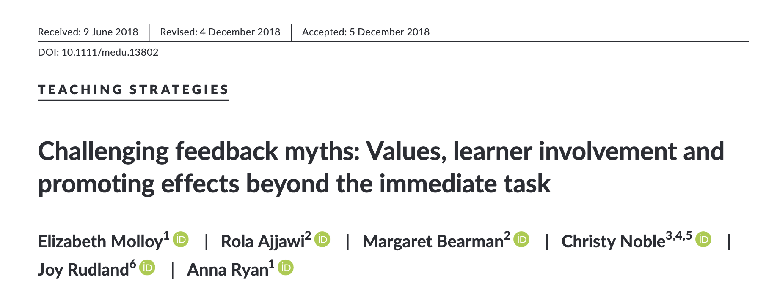
Myths of feedback
X
feedback needs praise-criticism balancing rules;
feedback is a skill residing within the teacher; and
feedback is an input only.

Slide 12
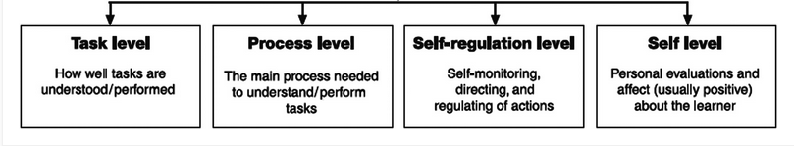
How does the educator ‘help’ the learner to the self-regulation
Hattie, J., & Timperley, H. (2007). The Power of Feedback. Review of Educational Research, 77(1), 81-112. https://doi.org/10.3102/003465430298487

Slide 13
Example scenario
You ask a senior student, final year, to examine the abdomen. This is in a clinic with 2 other students. The technique used is well below expectations at this level. The patient leaves and there is an opportunity to give feedback.
What process do you follow to ensure that the student is aware of the correct technique?

Slide 14
Main exercise
Using the previously scenarios: Consider this phrase.
I saw you struggling with aspects of that examination . . . how did you feel how it went, and what contributed to the ‘struggle’?
Anticipate what learner may say (list)? How does this influence the feedback and support you give?

Slide 15
Reasons
Reason given | Implications
Unclear of the standard expected and the expected level. | Have they seen the standard modelled (actual/video)?
Thought this was the right way of doing / thinking | Were they taught correctly? Did they learn incorrectly, why?
Didn't prepare | Why not? Not important, not interested, no time (working).
Haven't practice | Why not? Not important, not interested, no opportunity?
Get flustered easily (bottled it) | Observation tension - what can you do?
Was tired and or upset | Can you help, not indicative of usual behaviour?

Slide 16
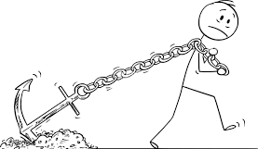

Slide 17
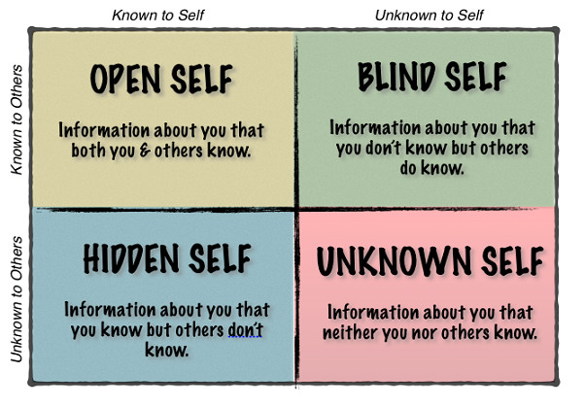
Johari's window

Slide 18
What may promote a learner to share vulnerabilities?
Place in chat
Notes:
Difficulty in establishing relationships with limited time – feedback literacy . . . . .

Slide 19
Motivational Interviewing
R Resist the righting reflex (resisting the urge to tell!)
U Understand the learners’ motivations
L Listen with empathy
E Empower the learner

Slide 20
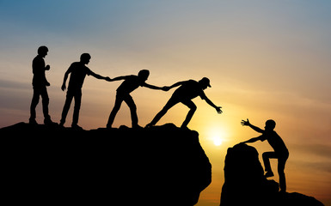

Slide 21

Do give feedback about task
When the opportunity presents explore further – support self-regulation
Build relationships and trust for effective feedback

Slide 22

Evaluation
We value your feedback.
We value your thoughts on this session so will give you 3 minutes to complete a short feedback form that has just been dropped into the chat.
https://otago.au1.qualtrics.com/jfe/form/SV_eePdo501YFRfJmm
You can also email us any time with feedback at edssu@otago.ac.nz
Notes:
3 min
I’d like to take 2 minutes before we close the session to give you an opportunity to give us feedback on this session. Please click the link in the chat to complete the very brief evaluation form. Thank you.
https://otago.au1.qualtrics.com/jfe/form/SV_eePdo501YFRfJmm

Slide 23
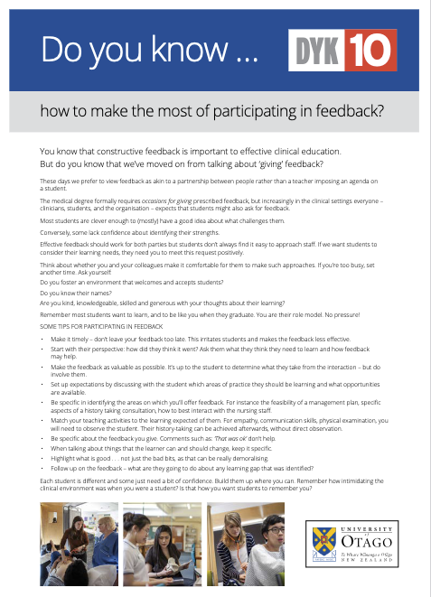
Resources
Challenging feedback myths: Values, learner involvement and promoting effects beyond the immediate task
Molloy, Elizabeth; Ajjawi, Rola; Bearman, Margaret; Noble, Christy; Rudland, Joy; Ryan, Anna
ISSN: 0308-0110 , 1365-2923; DOI: 10.1111/medu.13802
Medical education. , 2020, Vol.54(1), p.33-39
Hattie, J., & Timperley, H. (2007). The Power of Feedback. Review of Educational Research, 77(1), 81–112. https://doi.org/10.3102/003465430298487
. . . focus on Task . . . (the basics) But move to self-regulation and self

Slide 24
Karakia Whakamutunga
Unuhia, unuhia
Unuhia ki te uru tapu nui
Kia wātea, kia māmā, te ngākau, te tinana, te wairua i te ara takatā
Koia rā e Rongo, whakairia ake ki runga
Kia tina! TINA! Hui e! TĀIKI E!
Draw on, draw on,
Draw on the supreme sacredness
To clear, to free the heart, the body and the spirit of mankind
Rongo, suspended high above us (i.e. in ‘heaven’)
Draw together! Affirm!

