Slide 1
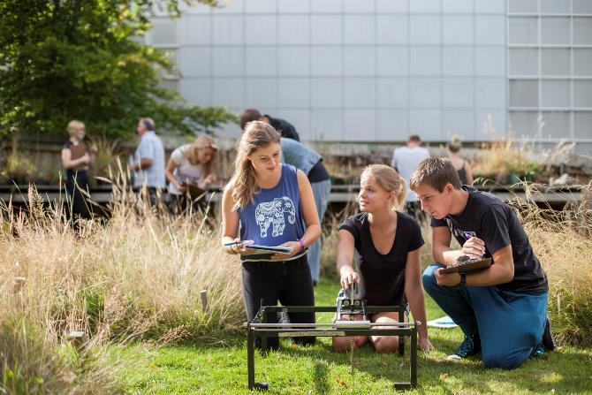
Why study Botany?
Why study Botany?
Topics, postgraduate opportunities, and employment potential from a BSc in Botany
otago.ac.nz/botany

Slide 2
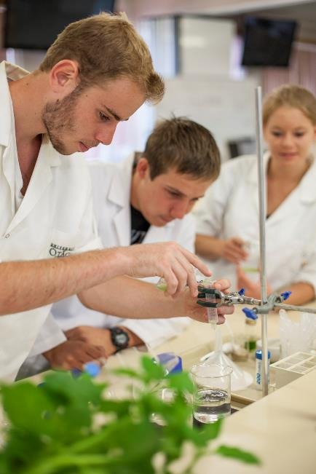
What is Botany?
A rose by any other name – Botany includes:
Plant Science/Biology (really just another name for Botany)
Plant Biotechnology (plant breeding, genetics, biochemistry)
Plant Ecology (plant interactions with the environment)
Mycology (study of fungi)
Phycology (study of algae)
It’s not horticulture – our students can’t necessarily grow a decent vegetable garden when they graduate, and it’s not all taxonomy – with over 260,000 species, our graduates aren’t able to recognise every plant…
A Botany graduate understands how plants work, how they interact with each other and animals, how we can protect ecosystems and biodiversity, and how we can best breed and use plants for food, energy, and materials

Slide 3
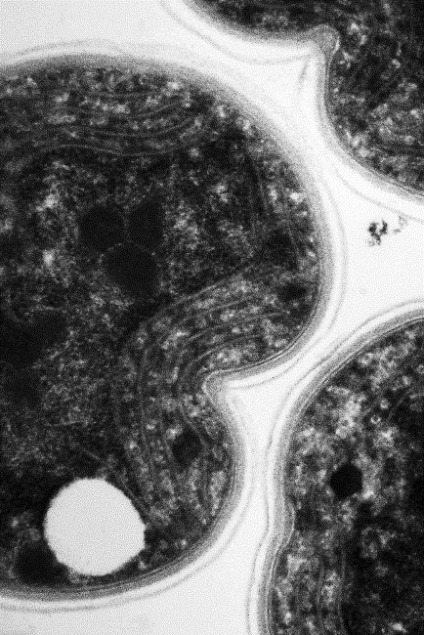
Take a deep breath and thank plants
The oxygen in about half the breaths you take come from trees and other land plants, the other half comes from phytoplankton
Both plants and phytoplankton work in exactly the same way – chlorophyll absorbs light and uses the energy to split water and release oxygen
Photosynthesis is the most efficient solar panel in the world – before it came along 1.5 billion years ago, there was almost no oxygen and very little life on earth
University of Otago botanists are investigating photosynthesis at the protein and genetic level in order to find new ways to harness bioenergy

Slide 4
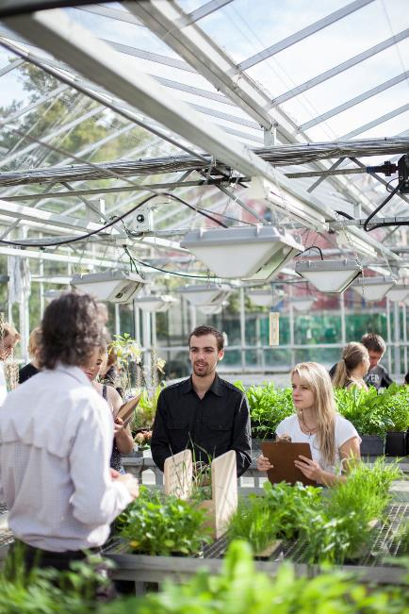
Hungry? Time to eat a plant
Plants, algae and phytoplankton are the basis of the food chain on land and in the sea
Feeding a growing human population in a changing climate will be one of the challenges of the 21st century
Plants’ thirst for nitrogen means that the fertiliser industry consumes ~10% of our energy supply - how can we breed crops that are less reliant on fossil fuel?
University of Otago botanists research how plants, phytoplankton and algae respond to climate change

Slide 5
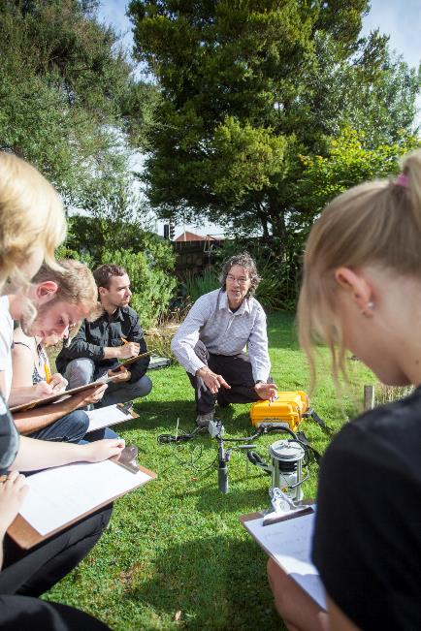
What else do plants give us?
Just in case oxygen and food aren’t enough…
How about clothing (cotton), timber, medicine (aspirin and penicillin to name just two), beer, wine, flowers, botanic gardens, forests, and ecosystems
University of Otago botanists don’t count plants, they:
investigate how the ozone hole gives unique properties to NZ wine
show that the spread of wilding pines in tussock grasslands could reduce Dunedin’s water supply
uncover sites where Māori gathered native plants to make textiles
discover how hidden relationships between fungi and plants in the soil keep our forests healthy
reveal how plant viruses threaten biodiversity and crops

Slide 6
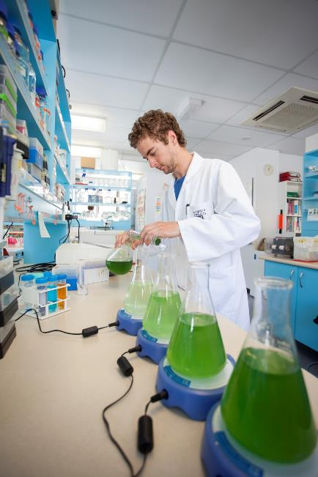
What will you learn in a Botany degree?
Field skills, experiment design, and ecological assessments
Lab skills, microscopy, tissue culture, and genetics
What parts of a plant do what – plants are much more than just roots, leaves and flowers
How plants sense, respond to and modify their environment, and their response to climate change
The ways in which different plant species communicate and interact with each other and animals to form stable ecosystems

Slide 7
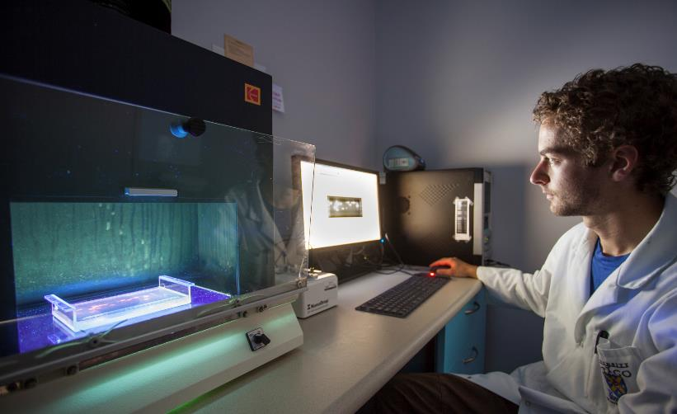
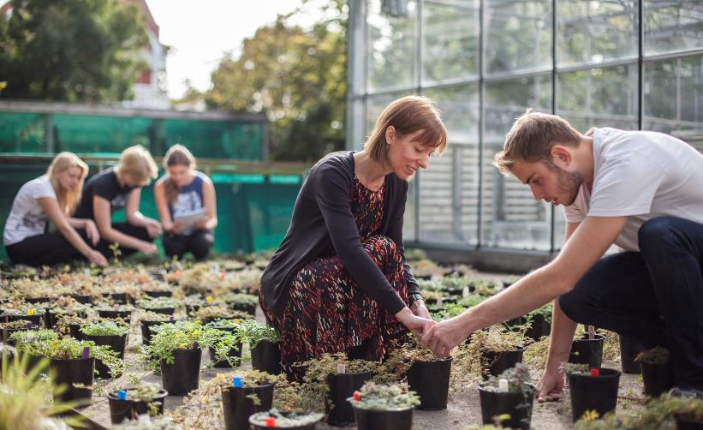
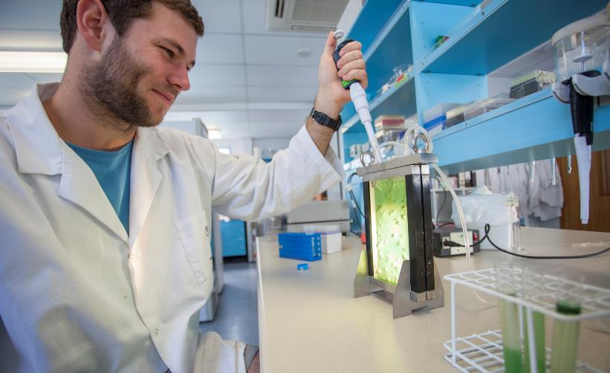
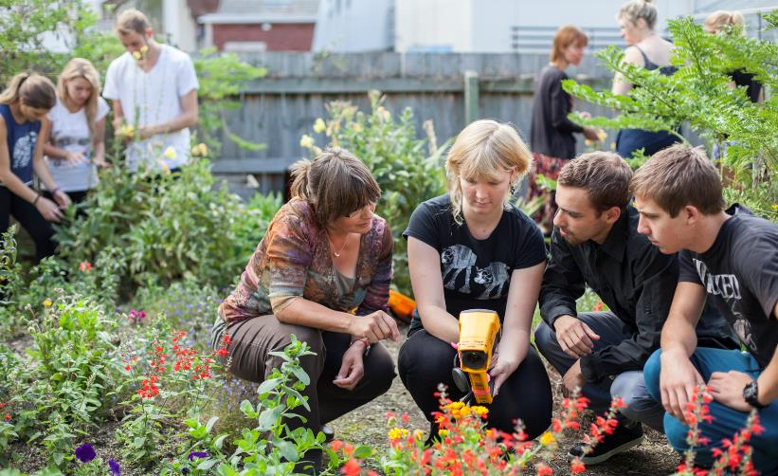
Notes:
Checking for genetic modification with DNA analysis
Growth experiments test how native Acaena (bidibids) evolved
Using bioreactors to improve the growth of cyanobacteria
Infra-red sensors show how flowers are a landing pad for pollinators

Slide 8
Studying Botany at Otago
You can study for a Bachelor of Science with Botany as a major or minor subject – Otago offers NZ’s only Botany degree program
At least NCEA Level 2 Biology is highly recommended
We have close associations with other programs, including Zoology, Plant Biotechnology, Marine Science, Food Science and Ecology – you can credit papers from these subjects towards your Botany degree
At postgraduate level, our students research alpine plant species, pollination, climate change, habitat modelling, evolution, genetics, phytoplankton, ocean acidification, cyanobacteria, lichens, photosynthesis, soils, fungi, tissue culture, UV stress, nutrients in food, antioxidants, postharvest food storage, viruses, and more

Slide 9
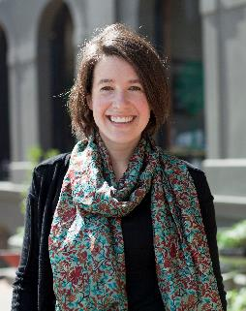
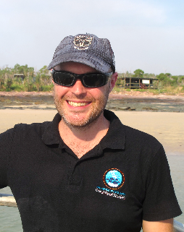
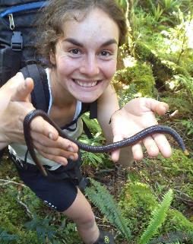
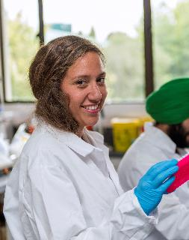
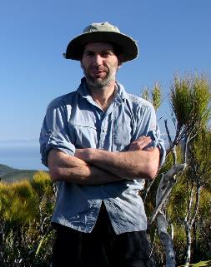
Where can you go with a Botany degree?
Our graduates work all over the world – for DOC, universities, Crown Research Institutes, NGOs, local government, industry, and more…
If you are interested in research, consultancy, or industry, you should consider an MSc or PhD after your Bachelor’s degree
Jinty MacTavish
Dunedin City Council
Dr. Chris Cornwall
Uni. Western Australia
Alex Ghaemaghamy
DOC Contractor
Suliana Teasdale
AgResearch
Dr. Kelvin Lloyd
Wildland Consultants Ltd.

Slide 10
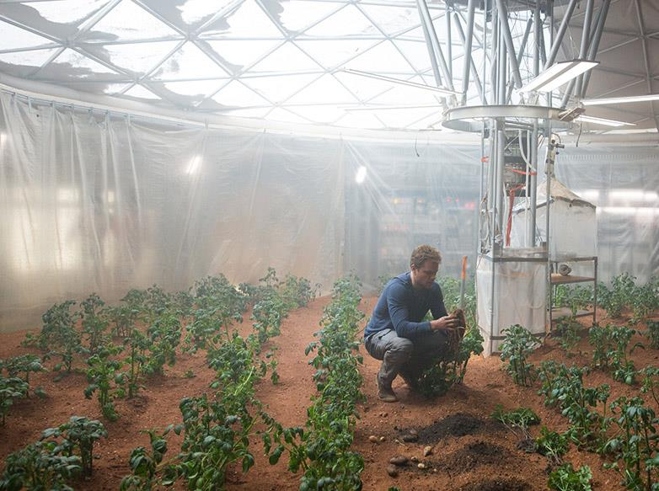
Heading to Mars? Don’t be like Matt Damon
In The Martian, a stranded astronaut needs to “use his botany powers” to grow potatoes for food on Mars
Potato plants, which are ~90% inedible leaves and stems, might not be ideal
But, if you do want to survive and terraform Mars, it would help to have:
cyanobacteria to efficiently produce oxygen
lichen to break down rocks, access their minerals and start making soil
algae to efficiently produce food and recycle the nutrients from waste
plants that are bred to grow and produce food in toxic soils, or in reduced gravity, for the 8 month space flight to Mars

Slide 11
What papers should you enrol in?
CELS191 – Cell and Molecular Biology
A critical paper for most biology degrees at Otago
BIOL123 – Plants: How They Shape the World
A second semester paper that covers a broad range of botanical topics and is a perfect opportunity to explore the subject
ECOL111 – Ecology and Conservation of Diversity
Learn how organisms interact and how we can measure biodiversity, and ecosystem health, and predict responses to environmental change
www.otago.ac.nz/botany
Facebook - @otagobotany

Slide 12
Thanks for listening!

