Slide 1
Local Food-EPI workshop
[insert name of council]
[insert date]

Slide 2
[insert slide/s outlining local information related to the impact of unhealthy food in the community]

Slide 3
Workshop aims
Help council representatives and local community to:
Identify and assess your council’s current progress
Identify and prioritise future council actions to create healthy and sustainable food environments

Slide 4
Workshop process
Step 1
Discussion and rating of current council initiatives
Step 2
Identification and rating of recommended future initiatives, and discussion of implementation pathways
Step 3
Feedback on tool/s and process

Slide 5
Step 1.
Discussion and rating of current initiatives

Slide 6
Current initiatives
[insert list of current policies & initiatives at this council that aim to improve food environments in the community]

Slide 7
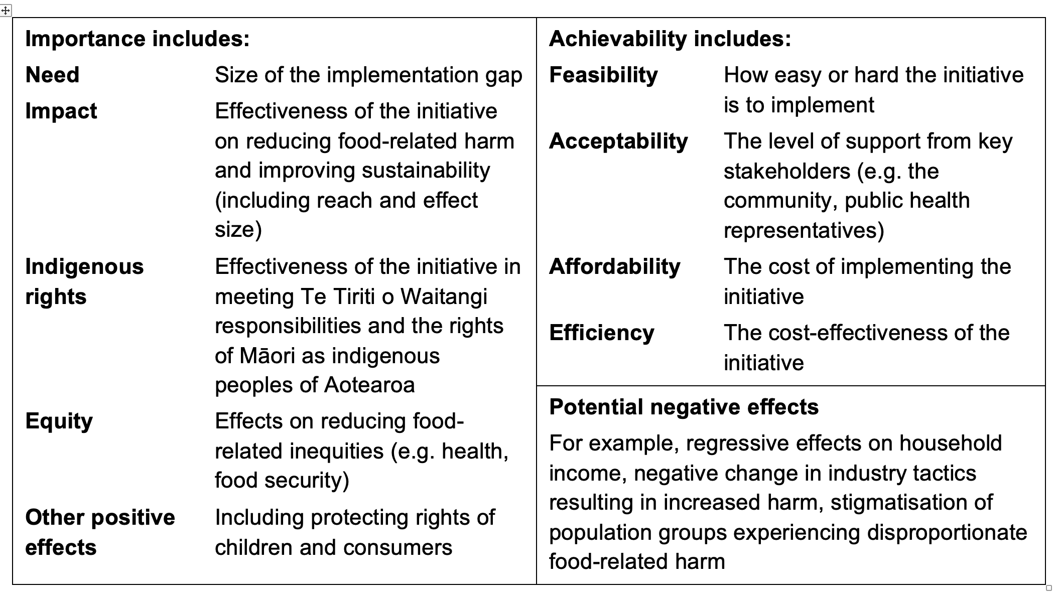
Table 1. Criteria for choosing initiatives for healthy and sustainable food environments

Slide 8
Discussion points (small groups)
Quality of the current initiatives (in relation to objectives, best practice, and the criteria in Table 1)
Strengths and limitations of the current initiatives
How are these initiatives being implemented?
Is there any monitoring of these initiatives (e.g. whether they are being implemented, consistency of implementation, impact)?
Any evidence of effectiveness of current initiatives?
How could these initiatives be improved?
Groups report back on main points of discussion

Slide 9

Rate current initiatives
Complete rating form on google forms (access via link)

Slide 10
Step 2.
Identification and rating of recommended future initiatives

Slide 11
Potential initiatives (Table 2 in Local Food-EPI document)
Examples:
Leadership (LEAD)
LEAD1: High-level support for healthy and environmentally sustainable food environment | To provide strong, visible high-level support for creating a healthy and environmentally sustainable food environment | LEAD1.1 Provide strong, visible high-level support (e.g. vision statements, high-level goals, in council policy documents, long-term plans, and strategies) and clear leadership (e.g. at council and in council staff) for creating a healthy and environmentally sustainable food environment that includes consideration of the specific needs of Māori through effective collaboration. | Christchurch City Council Food Resilience Policy. Objective: A food resilient Christchurch with thriving social, economic and physical environments providing healthy, affordable and locally grown food for all people. Auckland Climate Plan. Priority: Nga Kai/Food. Goal: A low-carbon, resilient, local food system that provides all Aucklanders with access to fresh and healthy food. Nelson to become Good Food City: a city that supports sustainable and healthy food, champions its local producers and works to reduce food waste. (Nelson City Council Long-term Plan 2121-2031). Wellington is one of 280 cities worldwide to sign the Milan Urban Food Policy Pact, which is a commitment to develop sustainable food systems that are inclusive, resilient, safe, diverse, provide healthy and affordable food, minimise waste, conserve biodiversity, and adapt to/mitigate impacts of climate change.

Slide 12
Food promotion (PROMO)
PROMO1: Healthy marketing, promotion, and sponsorship | To contribute to efforts to ensure healthy food environments that are free from exposure to unhealthy food marketing | PROMO1.1 Develop and implement policies and/or programmes to restrict exposure to the marketing and promotion of unhealthy foods and related brands in council owned/managed settings (e.g. parks and reserves, stadia, council buildings, buses, transport hubs or facilities) and at council-run events or events that require a council permit. PROMO1.2 Develop and implement policies and/or programmes to support recreation facilities, sports clubs and associations to eliminate sponsorship from brands related to unhealthy food. | Christchurch City Council Healthy Food and Drink Policy states that: “Leases, sponsorships, agreements, partnerships, fundraisers, associations and promotions relating to Council facilities and events involving products and brands that are consistent with a healthy food and drink environment are preferred.” Auckland Transport Advertising Policy: AT will have regard to advertising which supports health and healthy lifestyle choices. Healthy Families Hutt Valley led by council. Sports organisations that promote water as their drink of choice can reward their players with free access to 22 pools at six Councils across the Wellington Region, Horowhenua and Kapiti. Junk food advertising banned on London underground, train, tram and bus services, as specified in the London Food's Strategy report (2018). Only advertisements promoting healthy products are allowed.

Slide 13
Table 1. Criteria for choosing initiatives for healthy and sustainable food environments

Slide 14
Discussion points (small groups)
Which initiatives are possible in the current context of this council?
Which initiatives are relevant in the current context of this council?
Which initiatives could be considered in long-term planning? (e.g. included in long-term plan for possible implementation in later years)
Are there other initiatives (not in Table 2) that could/should be considered?

Slide 15
Whole group discussion
Which initiatives are both relevant and possible in the context of this council (currently or long-term)?
  (complete google docs form based on group consensus for each initiative)
Any additional initiatives that should be considered?

Slide 16
Short break to collate results
(coffee, tea, snacks)

Slide 17
List of relevant/possible initiatives
[insert list]

Slide 18
Discussion points (small groups)
Discussion of initiatives that are considered both relevant and possible in current context and/or for consideration long-term
Which initiatives are likely to reduce inequities and meet Te Tiriti obligations?
Which initiatives: (consider in relation to Table 1 criteria)
  Should be high priority for implementation?
  Would be “easy wins” (i.e. could be implemented relatively easily in this council and likely to have a positive impact on health and wellbeing of the community)?
  Would have the most benefit for this region’s community (overall)?
  Would have the most benefit in terms of reducing health and wellbeing inequities in this region’s community?
Which initiatives should be considered in long-term planning? (e.g. included in long-term plan for possible implementation in later years)

Slide 19
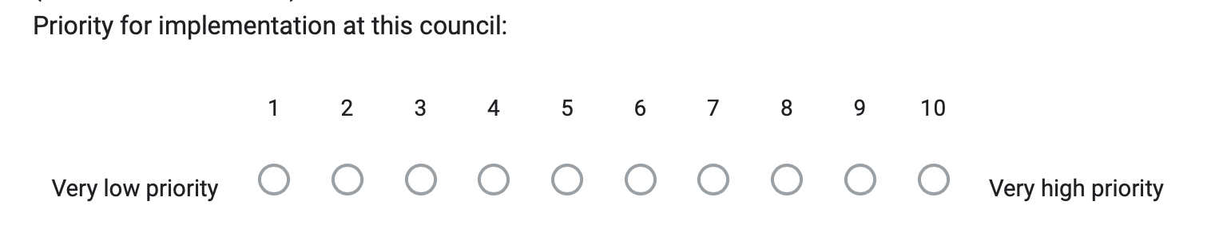
Rating initiatives to identify priorities
Survey on google forms
For each initiative identified as relevant and possible:
Final list of priority initiatives based on mean ratings

Slide 20
Rate proposed initiatives
Complete priority rating form on google forms (access via link)

Slide 21
Short break to collate results
(coffee/tea, snacks)

Slide 22
Results – list of priorities high to low
[insert list of priorities, based on collated results]

Slide 23
Discussion points (small groups)
How could the priority initiatives be implemented at this council for the best chance of successful outcomes?
    Considerations: add initiatives to current policies/plans (e.g. sustainability plan, climate plan, health & wellbeing plan), creation of healthy environments or health & wellbeing policy/plan/action plan, include in annual and long-term plans.
Where to from here/next steps?
Groups report back on main points of discussion

Slide 24
Step 3.
Feedback on Food-EPI tool and workshop process

Slide 25
Help us to improve the tool and process
Complete feedback survey on google forms
Questions about:
  Usefulness of the Food-EPI tool and workshop process
  How the tool could be improved
  How the workshop process could be improved

Slide 26

Thank you for your time

