Slide 1
Video Conferencing @ UOW
Where, How and What to ask for.

Slide 2
What is Video Conferencing?
It is collaboration between people
It is immediate
It can contain a mixture of live video & audio, prepared presentations and shared documents
The participants do not have to be in the same room

Slide 3
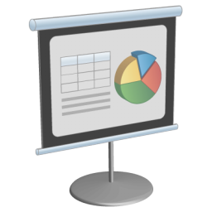
Having a meeting

Slide 4
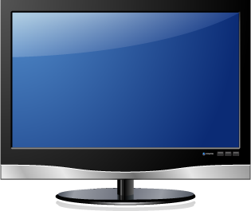
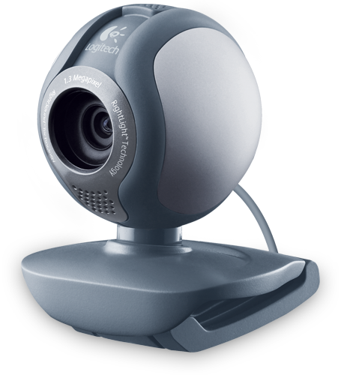
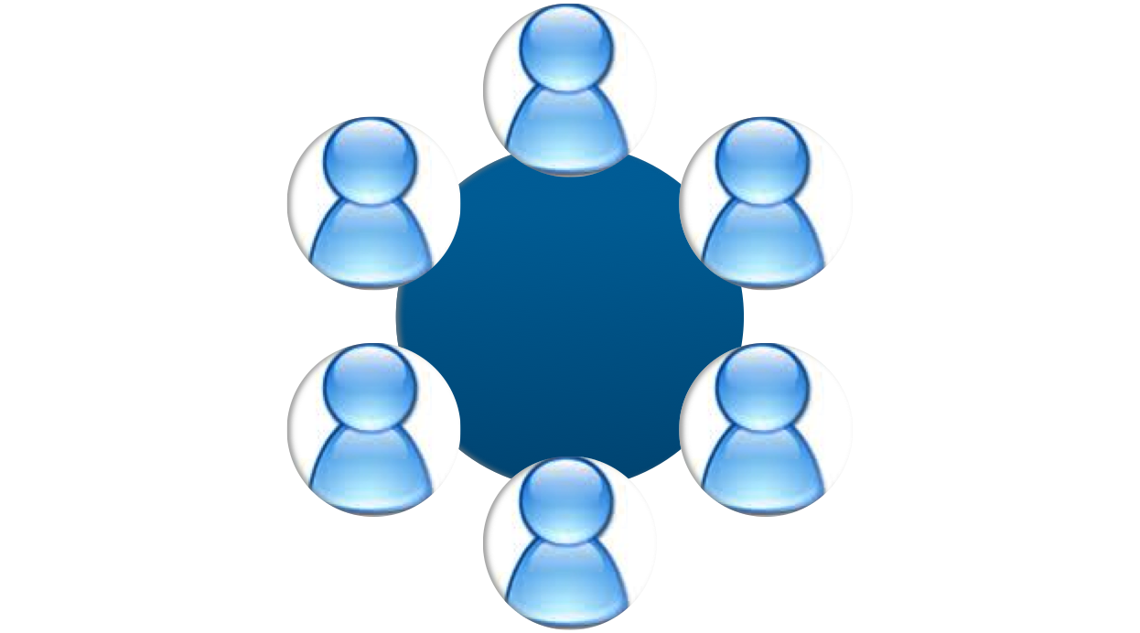
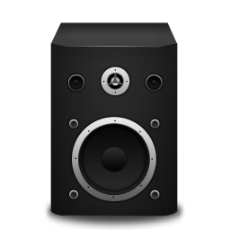
Meetings with many locations
Video
Audio
Data

Slide 5
Different types of services
There are many types of videoconferencing
Most require the same type of hardware at each site
Standalone units
Computers running the same software
Most require each site to be on the same type of network connection
Telepaeds
KAREN
The Internet

Slide 6
Different Networks
TELEPAEDS NETWORK
Skype
Scopia
THE INTERNET
Telepaeds
Connect
H323
KAREN NETWORK

Slide 7
How much does it cost?
There are no direct costs for using Video Conferencing here at UOW at this time
There may be costs for room hire
However there may be costs at the other sites!
Also consider:
They may be at home using their monthly quota
They may be off-site using their mobile plan

Slide 8
Summary of types
Telepaeds
Scopia/KAREN
Otago Connect
Hospitals
Interlinking
Teaching
Desktop PC
Meetings
Lecture Halls
Otago only
Teaching
Tutorials

Slide 9
Telepaeds
Most Hospitals in NZ have very strict internet security because of patient data
Telepaeds is secure and encrypted and runs on it’s own network
Hospitals mostly allow Telepaeds traffic but block Scopia, Skype, etc
Telepaeds is primarily to talk to our students in PN & HB, but can be used to talk to any other location on the Telepaeds network

Slide 10
Telepaeds cont.
Telepaeds Network
Wellington
Hutt
Palmerston North
Hawkes Bay
Hospital
Hospital

Slide 11
The KAREN Bridge (Scopia)
H323
The “standard” connection, “Standards-based”
Stand alone units (Polycom, Lifesize, Sony etc)
Desktop client (Scopia, Mirial)
KAREN Bridge, AVCC, Scopia
H323, Standards-based unit or desktop
Scales well, talking and presentations
Supported by Otago

Slide 12
KAREN Bridge cont.
KAREN Bridge
PC
MAC
Lifesize
Polycom
Scopia
Scopia
H323
H323

Slide 13
Interlinking
Connects the Otago Health Sciences Campuses in Wellington, Christchurch and Dunedin
Nordmeyer & D27
Otago only
Custom built by ITS for our use for meetings and teaching between the Otago campuses

Slide 14
Interlinking cont.
UOW
DSM
UOC

Slide 15
Otago Connect
Multiple desktop connections
Can easily share presentations, chat, notes, documents
Can be moderated by the presenter
http://www.otago.ac.nz/connect
Download the `Request a New Meeting Room’ application form

Slide 16
Otago Connect cont.

Slide 17
Other Connections
Skype
1-1 desktop connection unless you buy Pro version
Can easily share presentations
Established system and user base, worldwide “default”
Access Grid
Many–many computer based connection
Open source software
Tricky to use – first generation software

Slide 18
The Booking Process
How many UOW people?
Where are you connecting to?
What systems are available?
Make Booking
What rooms are available?

Slide 19
How Many UOW People?
The location at UOW to use will be based on number of attendees you have.
1: Desktop (Scopia, Skype, Connect)
1-5: D27 (Telepaeds, Scopia, Interlinking, Skype, Connect)
5-20: Seminar Rooms (Telepaeds)
20+: Nordmeyer (Telepaeds, Interlinking, Scopia, Skype, Connect)
Which connection types are available depends on the UOW location

Slide 20
Where are you connecting to?
Hospitals?
Otago Lecture Theatres?
A seminar room?
Someone’s office?
Someone’s home?
You will need to find out what equipment they have available for video conferencing. You may need to put us in contact with their technical staff.

Slide 21
What equipment is available?
There are many different “standards” of equipment and connection types.
We have access to a number of the commonly used systems. However, some systems may only be available in some places here.
Many other locations just have one system in one room.

Slide 22
Example 1
You want to have a small meeting with your Otago colleagues in Wellington, Dunedin and Christchurch
Book D27 via ITS in Dunedin – They will make sure all locations are booked

Slide 23
Example 2
You want to teach a TI class which has students in Wellington, Hawkes Bay and Palmerston North
Book the Telepaeds system via UOW Resource Bookings email, as you want to connect to Hospitals

Slide 24
Example 3
You want to teach the whole 4th year class in Wellington, Christchurch and Dunedin
Book Nordmeyer via ITS in Dunedin – They will make sure all locations are booked

Slide 25
Example 4
You want to talk to one person
You can use Scopia or Skype at your Desktop or D27. Check with TS to discuss options of room and methods of connection

Slide 26
Before you make a Booking
Are you the instigator or is someone else in charge?
How many at this end? (1, some or lots)
How many at the other end?
How many locations?
Who is responsible for bookings at the other locations?
Where are those locations? (Otago, Hospitals, other)
What you want to do? (talk, present, collaborate)

Slide 27
Booking many Otago Sites
Does your connection involve Otago University locations in DN or CH?
All VC involving multiple Otago campuses need to be booked centrally with ITS in Dunedin. They make the local UOW room booking as needed
Email: av.conf@otago.ac.nz
WWW: http://www.otago.ac.nz/its/videoconference/bookingform/
Or is UOW the only Otago location?
For example, you want to teach TIs in Hawkes Bay

Slide 28
Is UOW is the only Otago location?
You need to arrange the date & time of the meeting with all the participants at the other sites
The UOW location will depend on the connection type
The method of booking will also depend on the connection type
Booking a Telepaeds connection has a different process.

Slide 29
UOW – Telepaeds Booking
Check the Telepaeds availability calendar
http://goo.gl/VFFa2
Email resourcebookings.uow@otago.ac.nz with:
Time & Date
Other Locations (HB, PN, etc)
Which UOW room is required
Check http://resourcebookings.wnmeds.ac.nz/day.php
UOW contact person
Topic of booking (eg Tutorial Name)

Slide 30
UOW – Other bookings
Book a room and technical support via: http://resourcebookings.wnmeds.ac.nz
For questions and advice about possible future videoconference connections please email: videoconf.uow@otago.ac.nz

Slide 31
Connection Type Summary
1 to 1
D27 Desktop
Telepaeds Scopia Connect Interlinking
Small Group
D27 Seminar Rm
Telepaeds Scopia Connect Interlinking
Large Group
Nordmeyer
Interlinking

Slide 32
VC Booking Summary
VC Booking
Number of People
Other Locations
UOW Room
Connection Type

Slide 33
Connections available by room
Room & Type | Nord | D27 | Desktop | Lvl C & D | SLT | Dept Seminar
Telepaeds | YES | YES | no | YES¹ | YES | YES¹
Scopia (KAREN) | YES | YES | YES² | YES^{1,2} | no | YES²
Interlinking | YES | YES | no | no | no | no
H323 (KAREN) | no | YES | no | no | no | no
Skype | YES | YES | YES² | YES^{1,2} | no | YES²
Connect | YES | YES | YES² | YES^{1,2} | no | YES²
1: Only available in some rooms
2: You will need a camera and microphone and speakers/headset

Slide 34
Which to choose?
Need to consider:
Where you are connecting from?
Where you are connecting to? What do they have? How many sites?
What do you want to do?
Talk Face-to-Face?
Show a presentation?
Interact with documents and tools?
Use the right method for your needs

Slide 35
Transport Analogy
Visit a Friend:
Go by train, but not everywhere has a station
Go by car, but you’ll need a bus for a sports team
Go by plane, which some places prefer as you are security checked, but must land at an airport
However:
You can’t drive everywhere
Sometimes you need a boat
You need to ensure you can get to where you are going

Slide 36
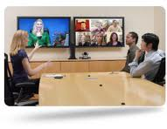
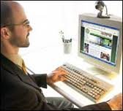
1 to 1

Slide 37
1 to 1
Standards-based unit or from your desk (Scopia/Skype)
Good for talking, can be ok for presentations
Small/cheap hardware ok
Laptop webcam
Headset w/ mic
Best to use D27 for presentations and lectures

Slide 38
1 – Some/Lots
Best to use D27
Good camera and microphone
Large screens and speakers
Good lighting and acoustics
Can accommodate up to 10 people
Can use desktop, but overall experience will be poorer
Low quality camera and mic
Sound issues / feedback with desktop mic and speakers

Slide 39
Some - ?
Best to use D27
Good camera and microphone
Large screens and speakers
Good Lighting and acoustics
Can accommodate up to 10 people
Can use desktop, but overall experience will be poorer
Low quality camera and mic
Sound issues / feedback with desktop mic and speakers
Only 2-3 people at most

Slide 40
Lots - ?
Nordmeyer seats 250+, but also zoom close for 15-30
Presenter and Audience Cameras
Wireless microphones and spotlights
Dual Screens for showing Presentation and Remote site(s)
Directly connected to Rolleston (CH) and Barnet (DN) Theatres

Slide 41
Multiple Versions
Telepaeds
Scopia
Interlinking
Skype
Access Grid
Adobe Connect (trial)
Direct IP
ViPr
These are all methods of VC which are suited to different types of connections, or are compatible with certain locations and systems.

Slide 42
UOW Systems
Telepaeds
1 to 1, multi-site (Lvl C&D, some dept rooms)
Links to HB, PN, Hutt Hosp. 150 others
KAREN Bridge (Scopia / Direct IP)
1 to 1 (Desktop, D27), multisite (D27, Nord)
Standards based connection – Lifesize, PC (Scopia)
Interlinking (Conference XP)
1 to 1 (D27), multisite (D27, Nord)

